Slide 1

Collaboration not Competition
Growing craft beer through collaboration
Will Keating – Hellfire Brew Club/Serestra
Notes:
Will Keating, Principal - Serestra & Hellfire Brew Club – Ireland
➔ Title: Growing craft beer through collaboration
➔ Description: Join Will Keating, Principal Serestra & Hellfire Brew Club on how brewers can use collaboration brews to build relationships, open new markets, gain technical experience, reach new consumers and have fun! Find out through a couple of examples of successes from Europe/US and perhaps an example of when it didn’t work quite so well, finishing up with some practical advice on how to go about selecting and working with a potential collaboration partner.
⇨ Focus : collaboration, not competition, as a growth driver:
- an overview of how smaller brewers can use collaboration brews to build relationships, open new markets, gain technical experience, reach new consumers and have fun!
- through a couple of examples of successes from Europe/US and perhaps an example of when it didn’t work quite so well
- finish up with some practical advice on how to go about selecting and working with a potential collaboration partner.

Slide 2
1
Simple Thought
3
Good Reasons to Collaborate
5
Practical Tips to Collaborate Better
Notes:
I want to talk about how we can use Collaboration , not competition to grow your brewery.
Competition is good but sometimes, collaboration is better!
I’m going to talk about how this fits in with your overall business plan
What the most important things to consider when deciding to collaborate
And the top tips for making a practical success of your next collaboration
All the while, I will be referencing some examples, personal and public, of collaborations that have succeeded
We only have 20 mins so I’m going to make sure that we clip along at a good pace and I’m looking forward to taking questions in the panel session that follows or people are very welcome to contact me after if you would like to know more, or indeed to collaborate!

Slide 3
Craftmanship
Commercials
Collab.
Curiosity
Culture
Notes:
Firstly, let’s acknowledge that collaboration is only one of the growth drivers of your business.
I like to keep things simple so I often think of the 5Cs: Craftmanship, Culture, Curiosity, Commercials and Collaboration
Craftmanship is all about making sure that all of the care, skill, attention and love that you put into your brewery is evident in the beer that ends up in you customers hands. Everything from the liquid to the logo on the glass and the advertising on the billboard outside or the phone in their pocket should be crafted to tell your story.
Even in a small brewery you are not alone, so Culture is about making sure that everybody that you work with shares your objectives, employees naturally but suppliers and customers can be powerful allies if they recognise and buy into your culture too.
Curiosity may sound like an odd growth driver but it is perhaps the most essential, as without curiosity there is no motivation to change or learn and without them we would all still be brewing gruit beers in clay pots in our villages.
Commercials, obviously enough for any brewery to go from “small to success” making sure that you know how to make the best financial decisions for your brewery is vital. From the minutiae of understanding your COGS to the focus of beating your competition nobody succeeds without strong commercials
All of the above are common to many if not most industries but in brewing we have a big advantage in that we can also use Collaboration as a growth driver. This isn’t new but it’s certainly new to lots of brewers… so understanding why and how is important.

Slide 4
3 Good Reasons
You’re not that big a deal really.

Slide 5
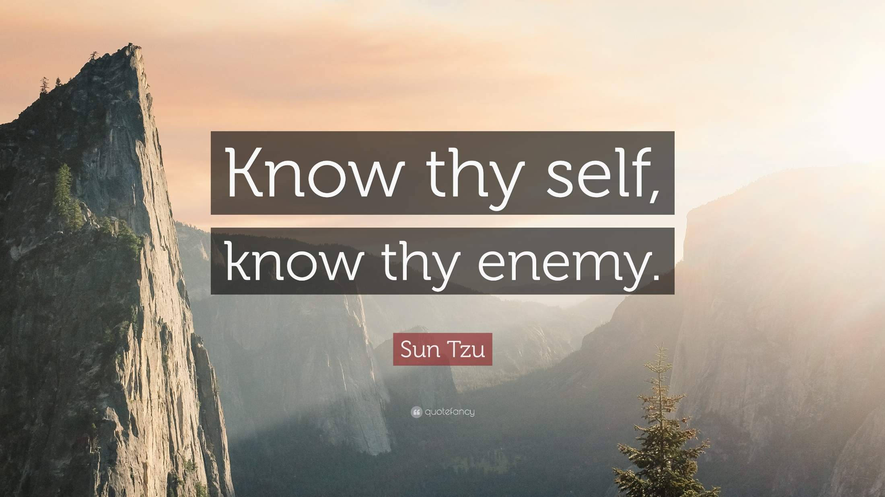

Slide 6

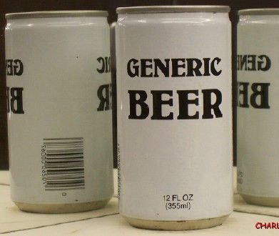

Notes:
Lets talk about the Why? first of all…
Competition needs to be defined… are you in competition with the micro brewery down the road?
Are you in competition with the macro brewery in the next city?
Are you in competition with the vineyards of a neighbouring country? Or the distilleries owned by a global conglomerate?

Slide 7

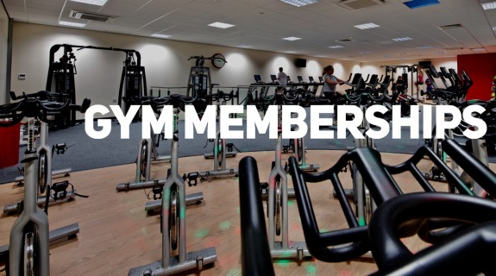

Notes:
Or are you really in competition with and the local 24 hr gym, Netflix or the dreaded Facebook?
Ultimately everybody in the brewing industry is competing for a slice of people’s leisure time.
Nobody needs beer, it’s simply something that we happen to enjoy when we aren’t busy doing the hundreds of other things that we prioritise in our lives.
And an ever increasing number of brands, companies and XXX are competing for our slice of time.

Slide 8

+5,000 messages
Notes:
Research has shown that we are exposed to thousands upon thousands of messages every day, emails, advertisements, billboards, radio ads, Special offers on the supermarket shelf… +100,000 SKUs in a supermarket!
The only our brain can cope is by automatically deselecting / filtering out those that it decides subconsciously don’t matter.
We therefore only notice or pay attention to relevant messages and one

Slide 9
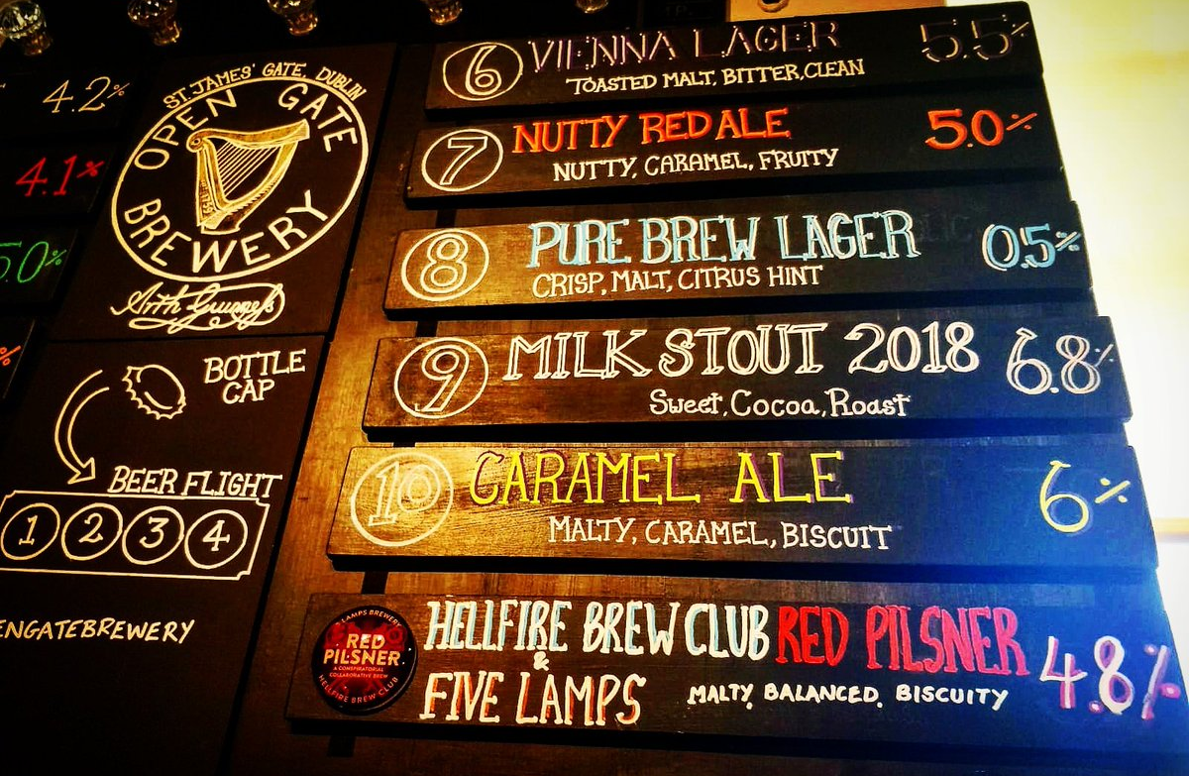
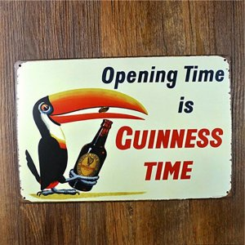
Our brains favour novelty.
Notes:
90% of POS spend is wasted in an outlet.
If you see the bigger picture, collaborating with another brewer doesn’t seem such a big deal.

Slide 10
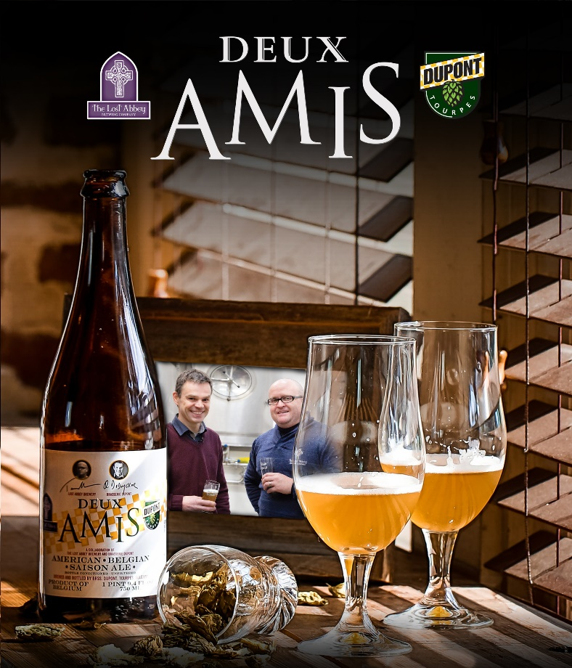
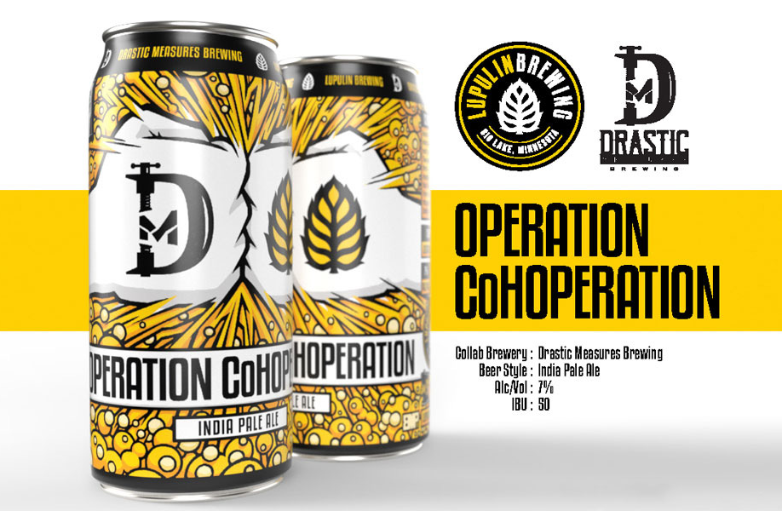
New News
Notes:
In marketing speak we talk about driving reach via common mental & physical availability channels but in essence we meant that novelty gets noticed. In other words to be news, it helps to be new,
Wether it’s Saison Dupont doing their first ever collaboration or it’s a newer US micro brewery like Lupulin doing an almost “by the numbers” collaboration, it’s so much easier to get noticed by consumers when you are talking about something new. This is a huge advantage to your brand, as long as you are saying something that resonates with your core offering. Which brings me neatly to my next point…

Slide 11
3 Good Reasons
It helps you express your purpose.

Slide 12
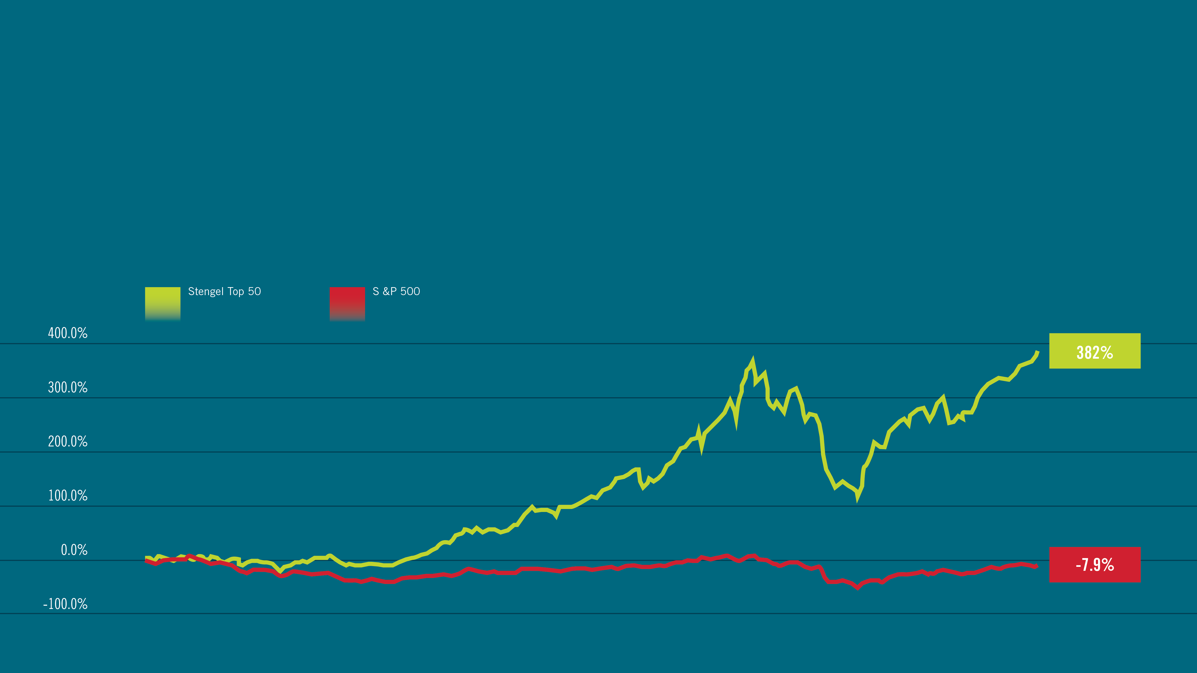
PURPOSEFUL BRANDS
Purpose driven brands are more successful – long term
Stengel – 50,000 brands surveyed 2001-11
Notes:
We know that brands with purpose are more likely to be successful because they consistently communicate a higher order emotional benefit to the consumer and the are CONSISTENT
This view is substantiated by the work Jim Stengel has done that scientifically demonstrates that purpose driven brands are more successful than brands which are not.

Slide 13

Push Convention
Notes:
Push out the envelop…..

Slide 14
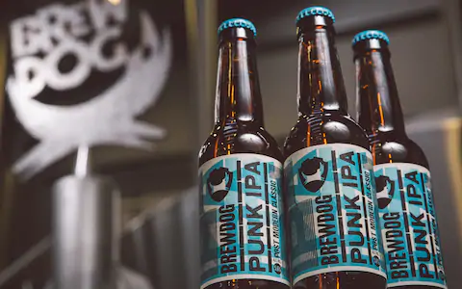
Fuck Corporations & Bland Beer

Slide 15
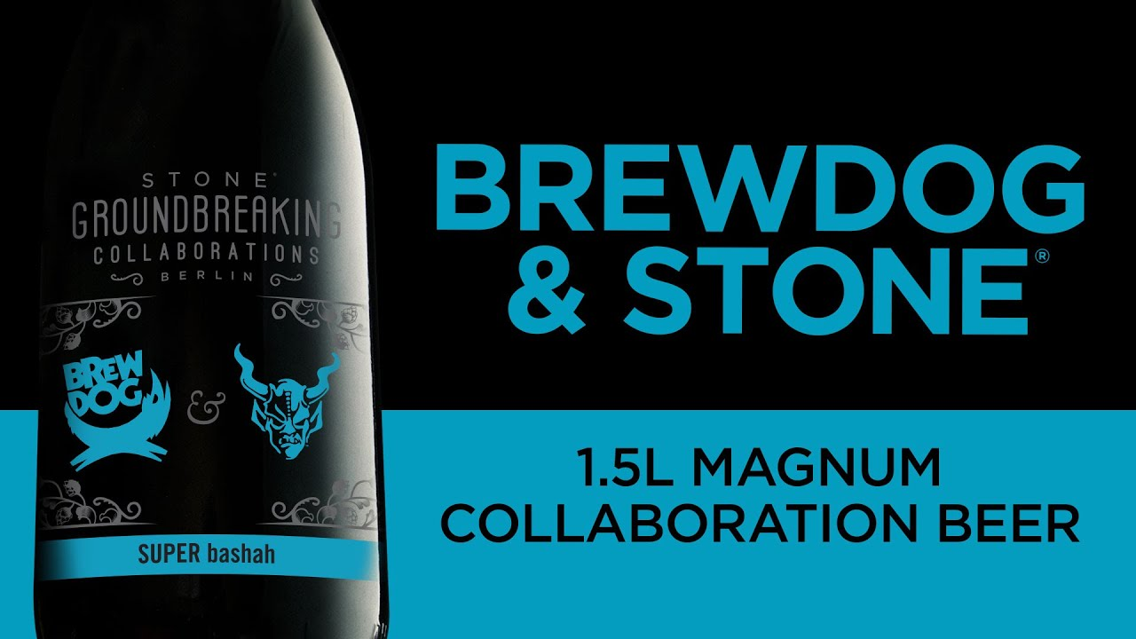

Slide 16
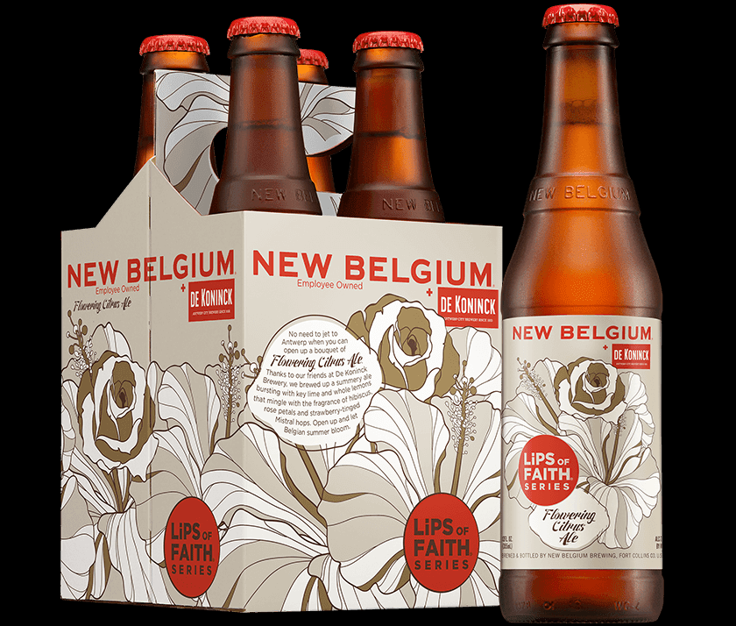
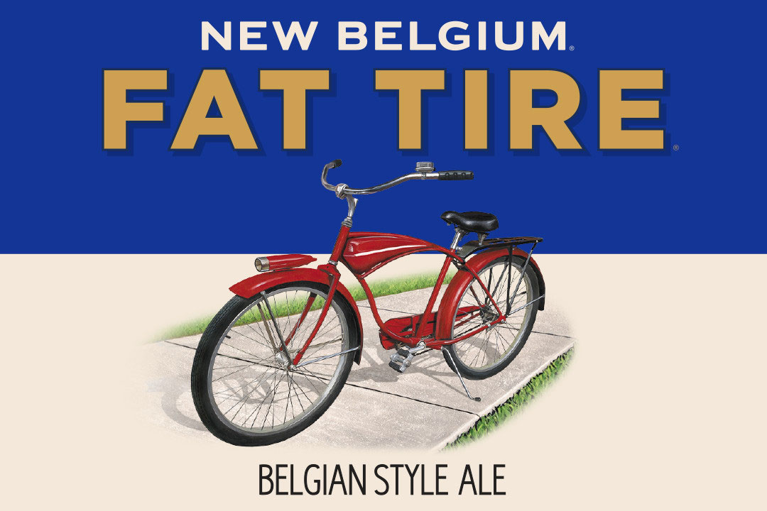
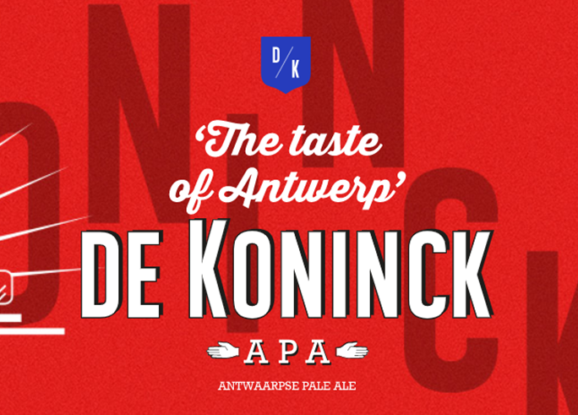

Slide 17
3 Good Reasons
You’ll learn something/ meet somebody new.

Slide 18
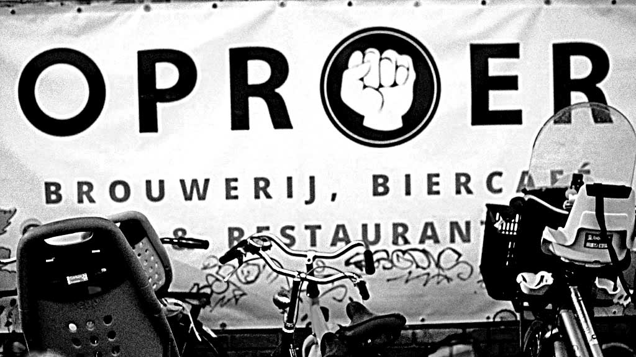
Notes:
Maybe you wanto break into a new market?
Oproer connected with brewers in Portland, Or, and now have a distribution deal…

Slide 19
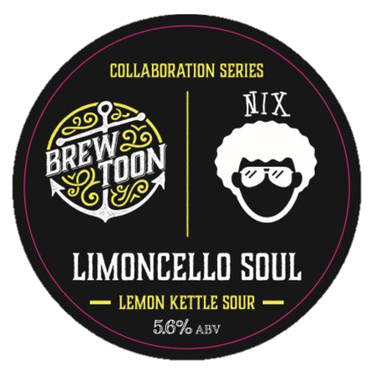

Slide 20
5 Practical tips
Notes:
So it that’s the high level, strategic thinking, what practical, tactical advice would I give?

Slide 21
Ask the awkward questions first…
5 Practical Tips:

Slide 22
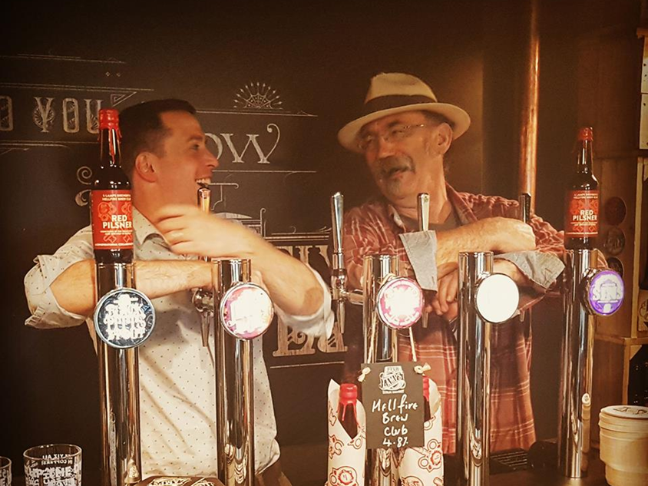
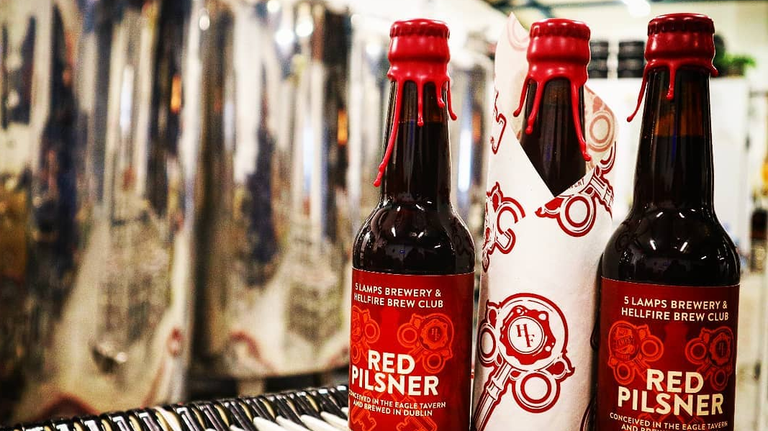
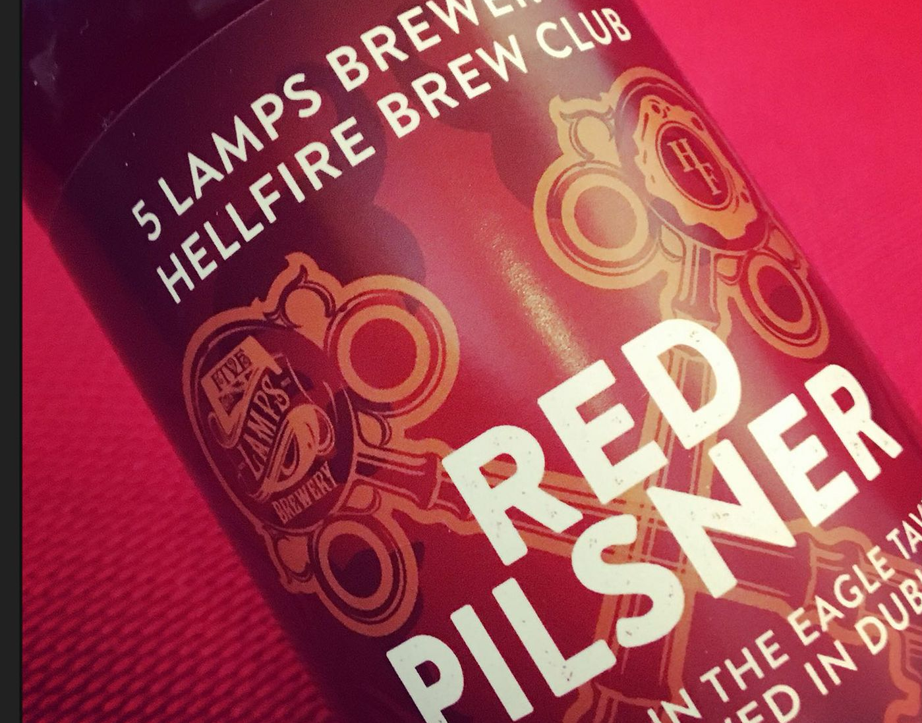

Slide 23
Who will brew the beer?
What will the inspiration be?
How does the recipe come about?
How do you agree a design?
Who promotes the brew and how?
Do you both have the right to re-make it without the other?
How is your contribution valued?
Who has the final say if there are issues?
Host & Guest roles /“Simul-brew” /Pay to play

Slide 24
Beyond brewers
5 Practical Tips:

Slide 25
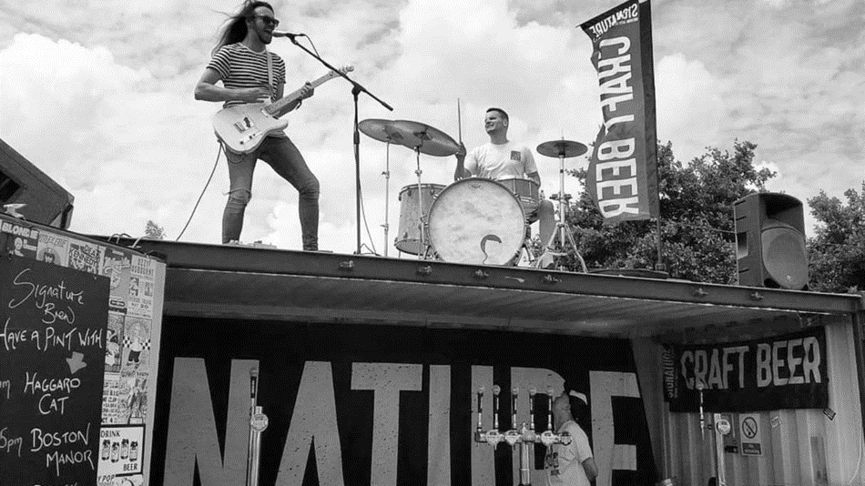

Slide 26
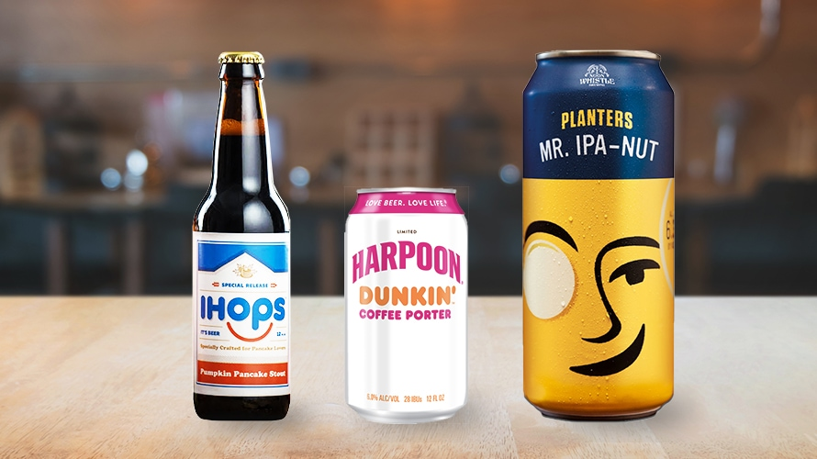
Notes:
Collaborations inspired by Product
Meaningful collaborations – these work functionally, do they have comparable brand purposes?

Slide 27
Join the dots…
5 Practical Tips:

Slide 28
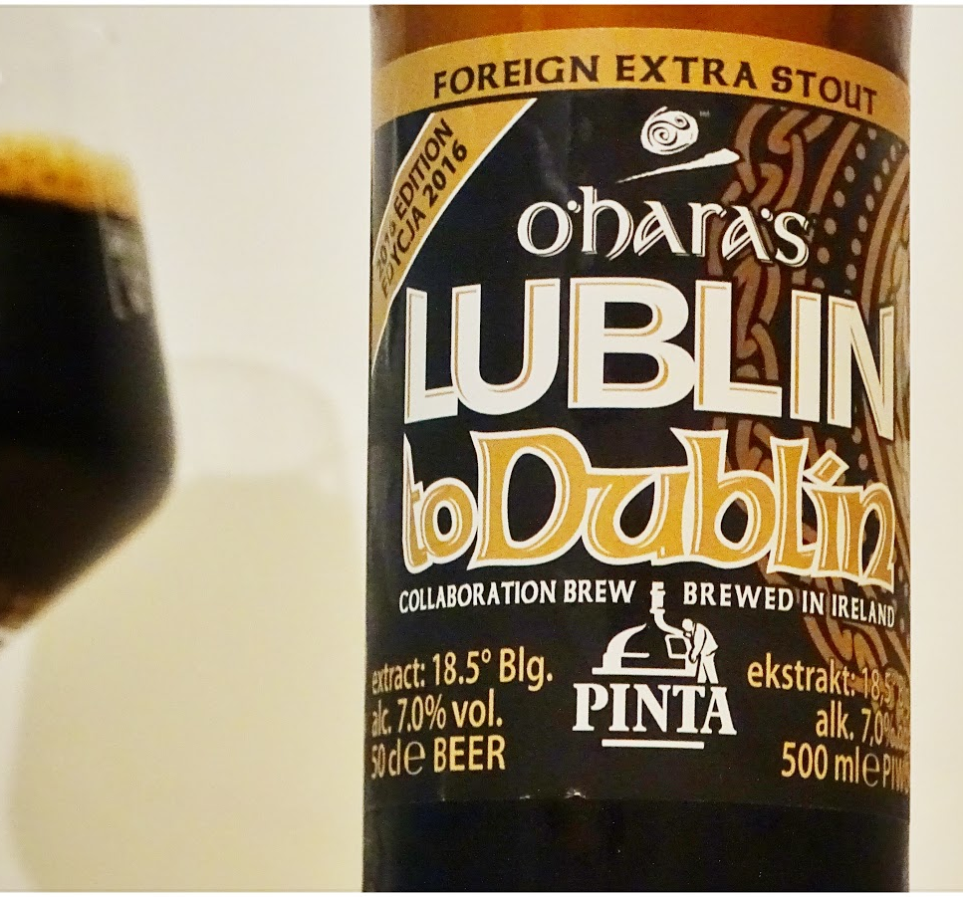
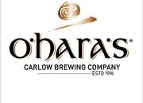


Slide 29
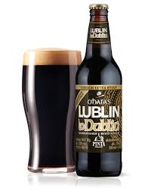
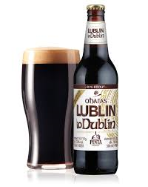
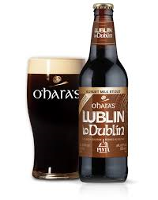

Slide 30

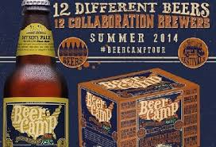
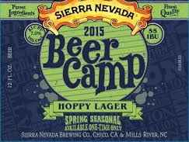
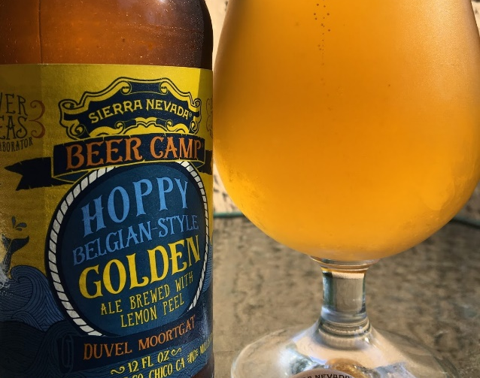
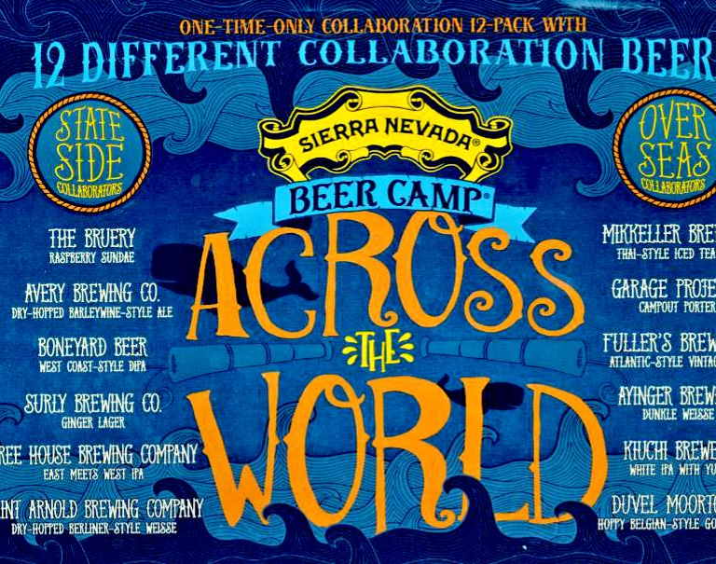

Slide 31
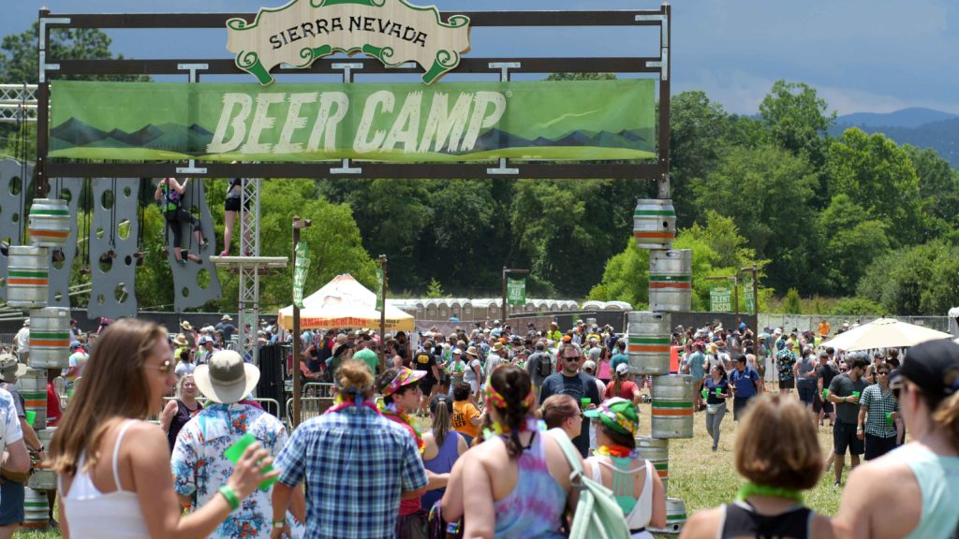

Slide 32
Embrace the random
5 Practical Tips:

Slide 33
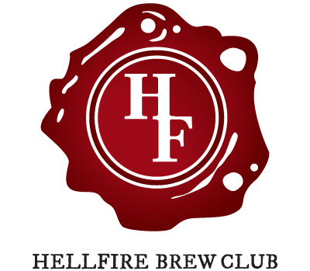
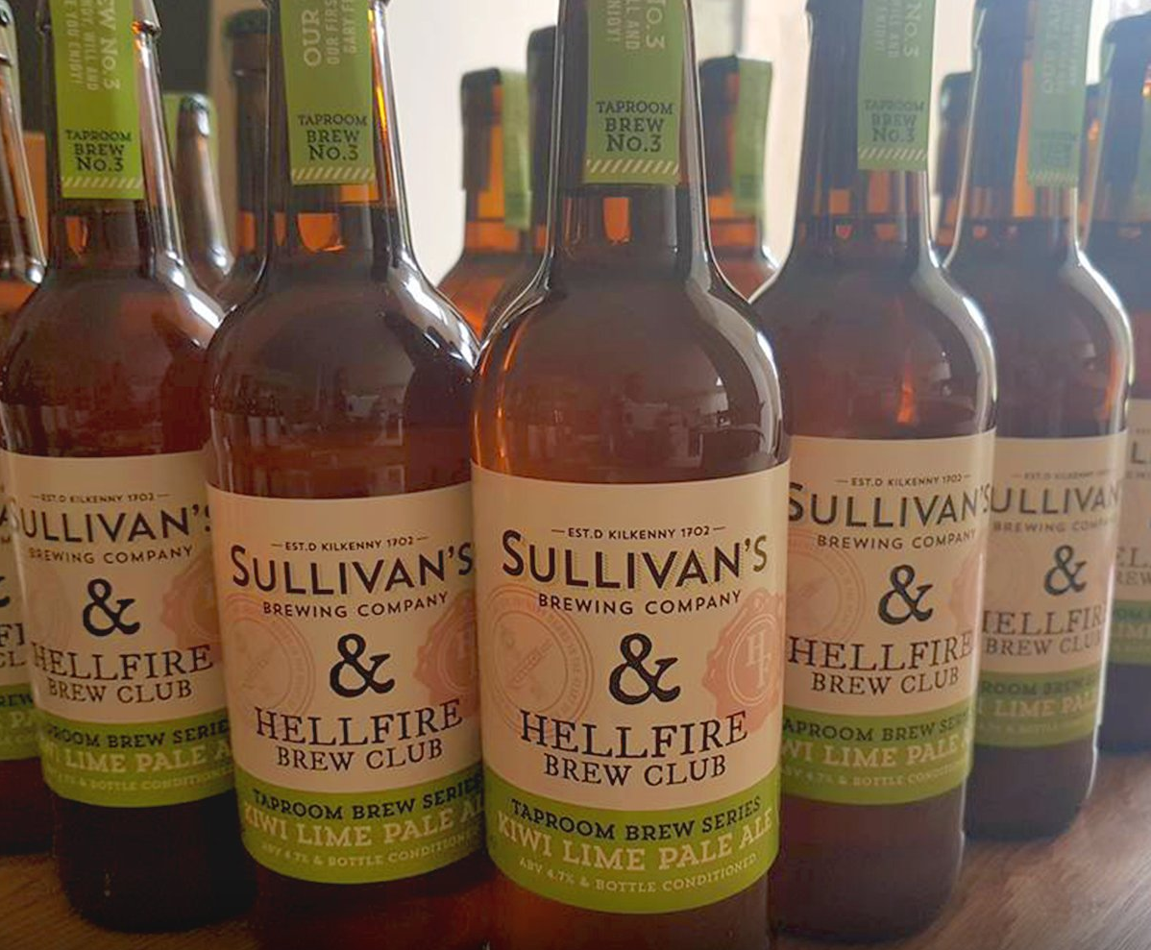
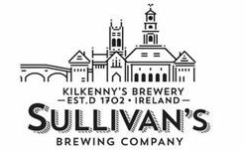

Slide 34
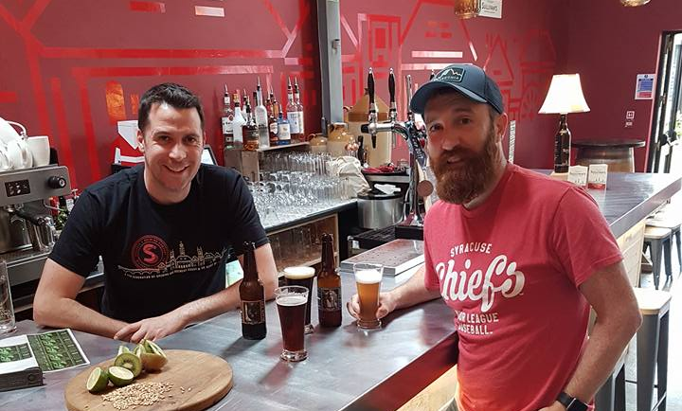
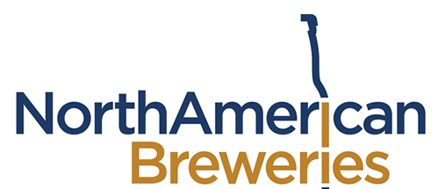
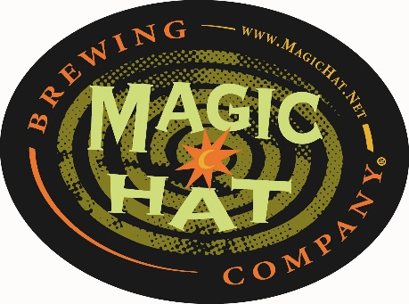
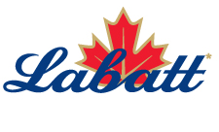

Slide 35
Don’t forget to have fun…
5 Practical Tips:

Slide 36
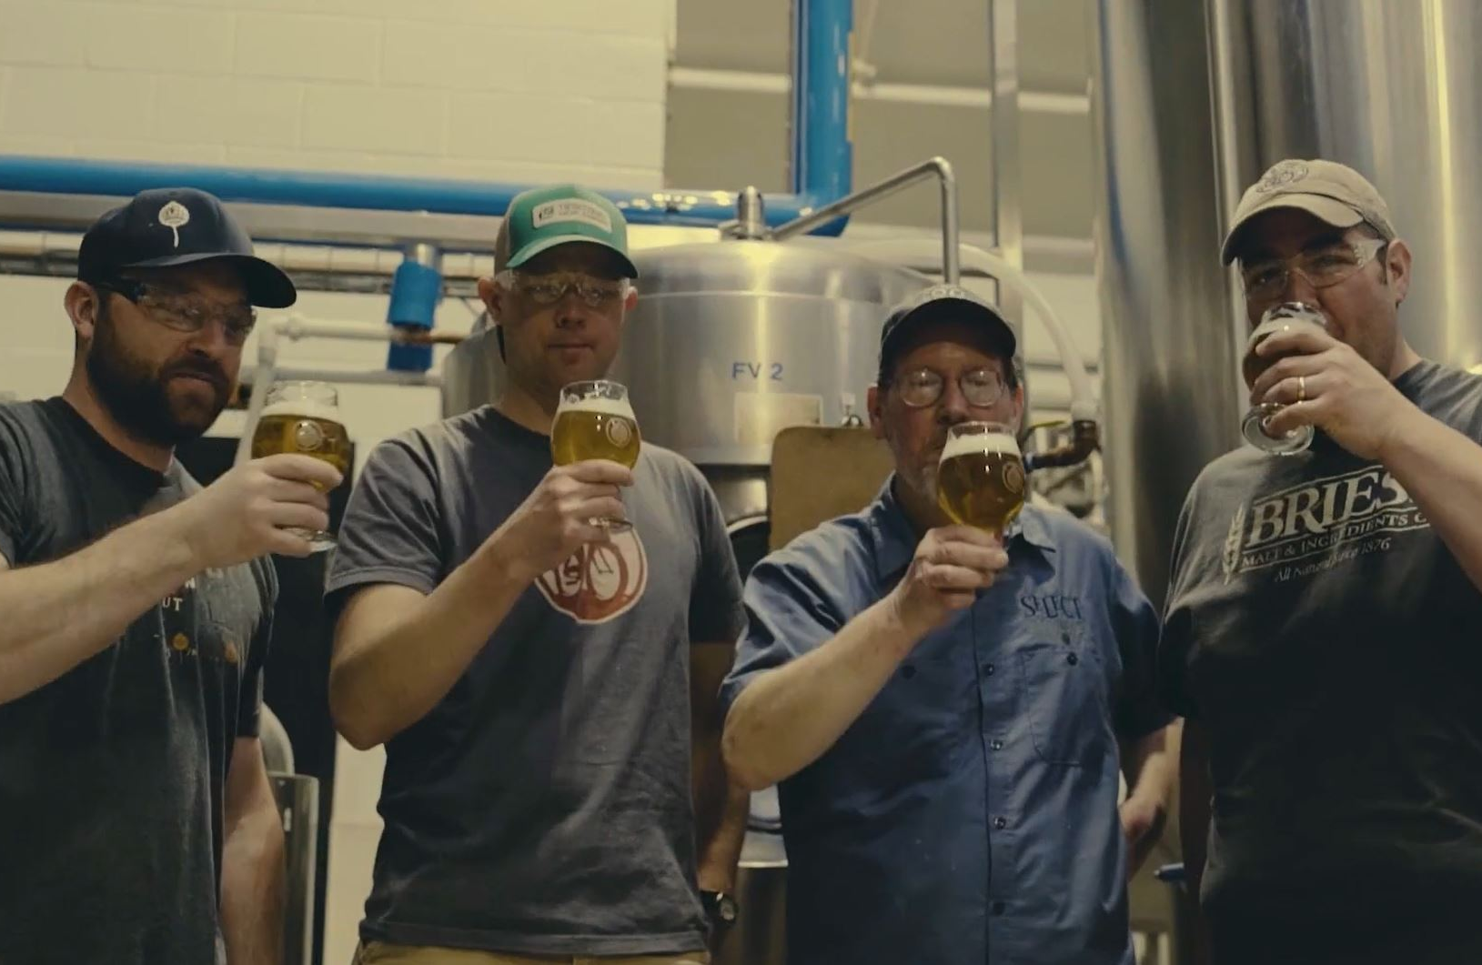
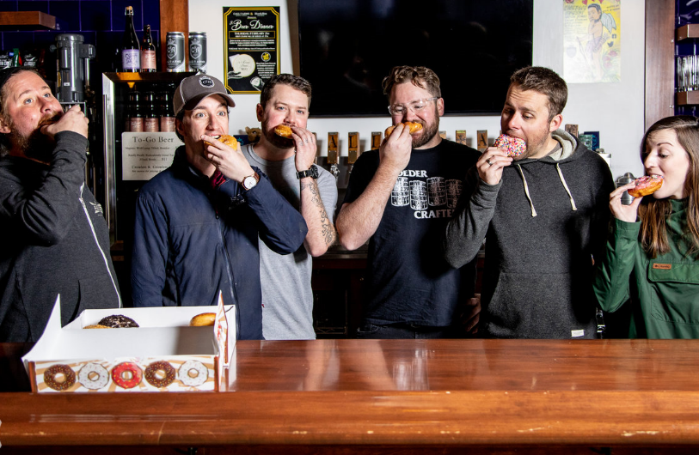
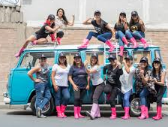
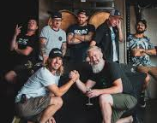
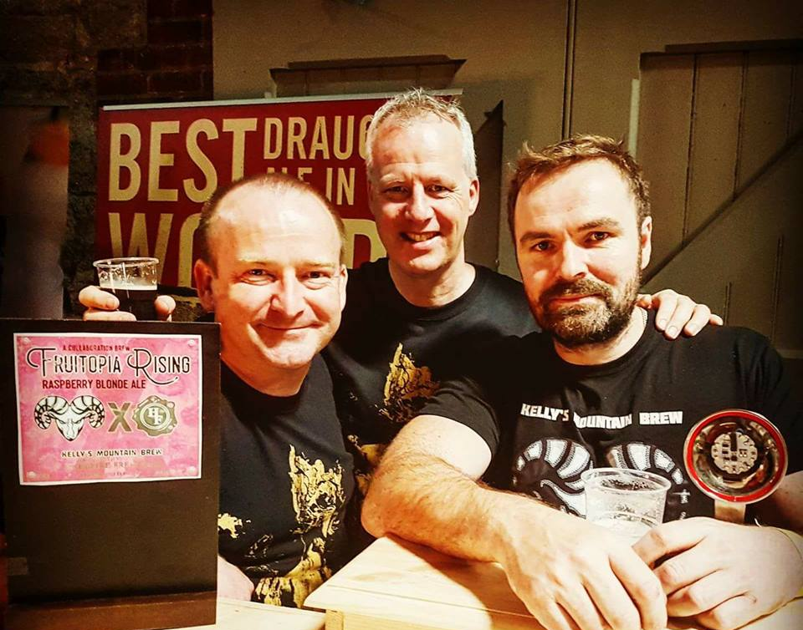

Slide 37
5 Top Tips
Ask the awkward questions first
Beyond brewers
Join the dots
Embrace the random
Don’t forget to have fun!

Slide 38
3 Good Reasons
You’re not that big a deal really
It helps you express your purpose
You’ll learn something new
Notes:
Drive reach through novelty in shared mental and physical availability
Amplification of common brand values
Challenge existing brewing ideas and bring your beer to another level & Build community within the brewing world

Slide 39
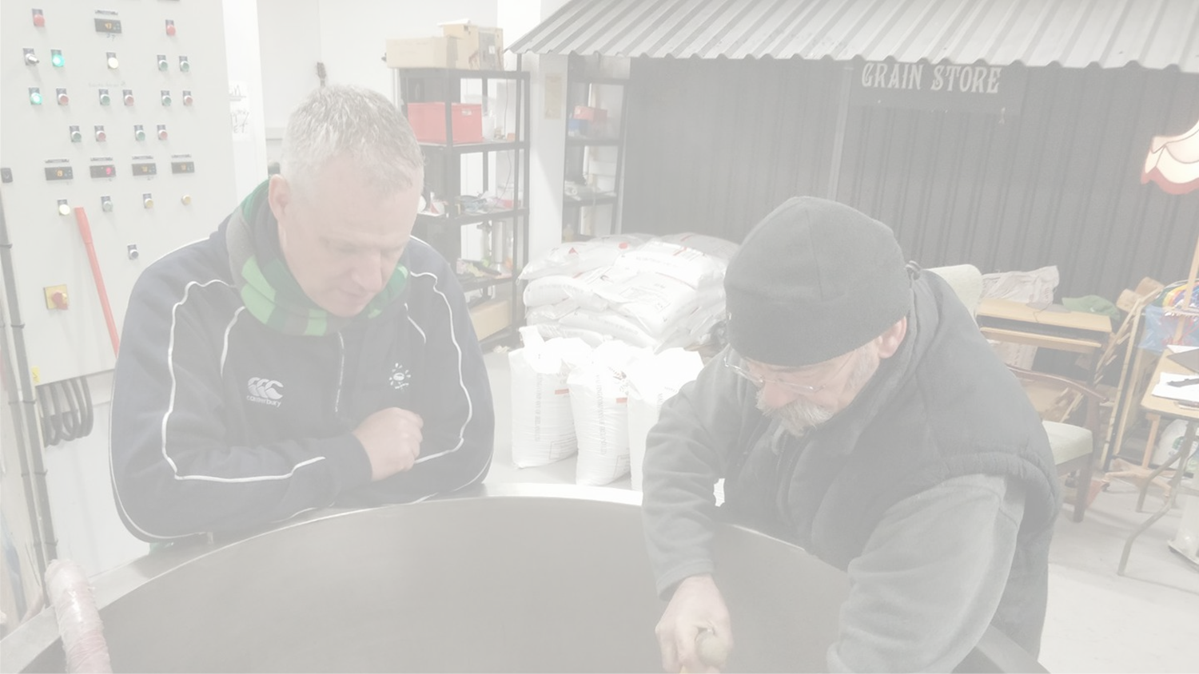
1 final thought…
Ultimately, consumers want more stories and more flavour from their beer.
Collaboration is a roadmap to both.

