Slide 1

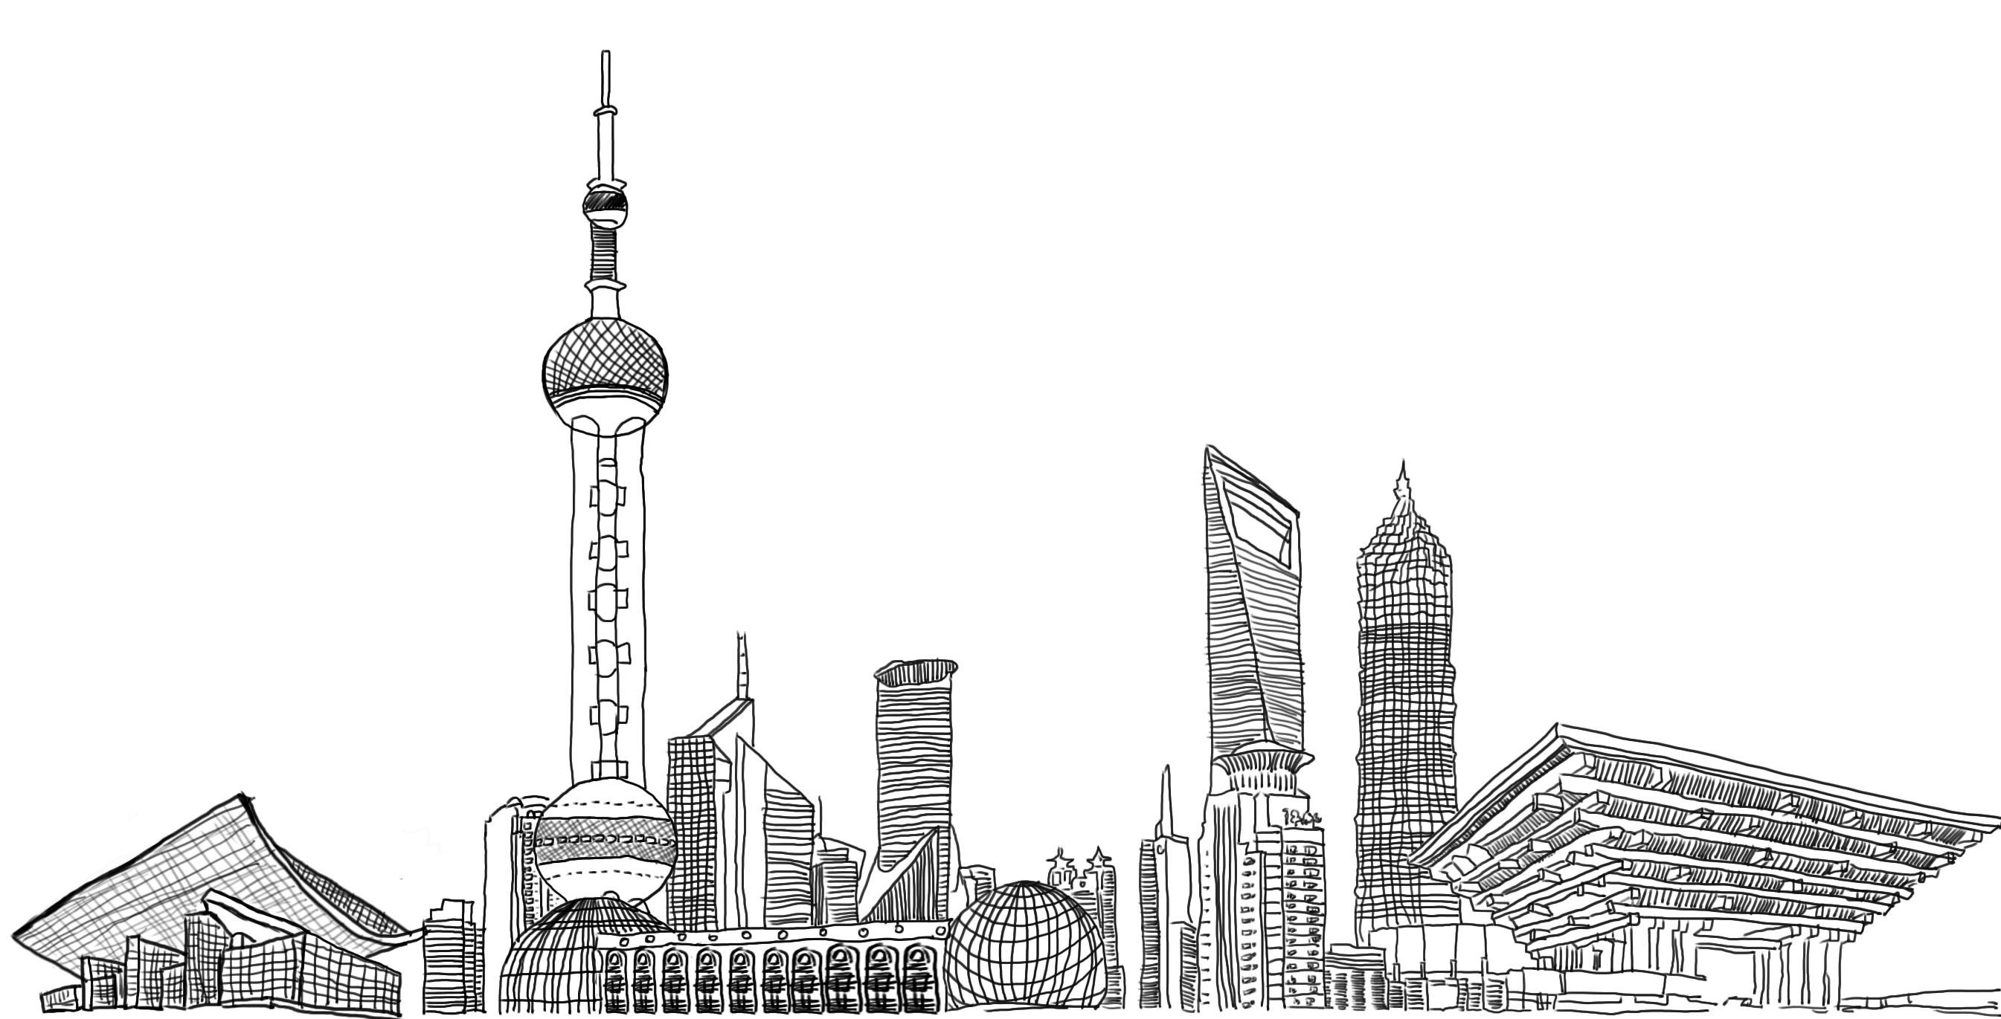
Craft Beer In
CHINA
Trends & Opportunities
Michelle Wang
The Beer Link

Slide 2
CONTENTS
01
02
03
Market Overview
Trends
Opportunities

Slide 3
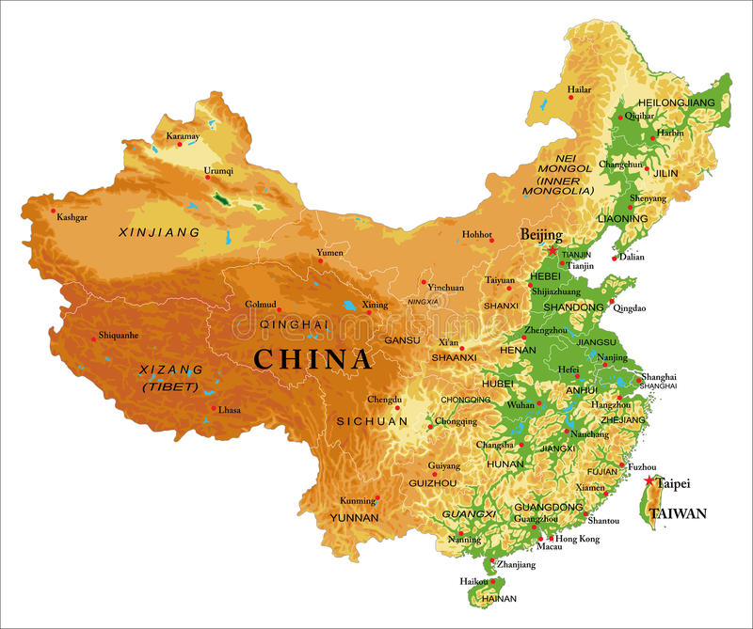
CHINA
Size: 9,600,000 km²
States: 34
Provinces: 23
Autonomous Regions: 5
Province level Municipaliti:4
(Shanghai, Beijing,Tianjin, Chongqin)
Special Adminsistrative Region: 2
(Hongkong, Macau)
Nationalities: 56
Dominated Nationality: Han
Languages: 80+
Official Language: Mandarin
Major Cuisine Style: 8
Notes:
这里主要是讲中国是一个多民族国家，不同地方，不同气候，不同风俗习惯，不同文化。所以当我们在说想进入中国市场，很难把中国当成一个大市场，而是应该当成一个欧盟来看待。

Slide 4
Market Overview
-Production
-15.8%
Notes:
2013产量达到顶点，啤酒消费已经饱和，2017，2018持续平稳

Slide 5
Market Overview
-Importing
904.3 MILLION USD

Slide 6
Market Overview
-Importing
Beer Importing by different Coutries 2014 ($)
Beer Importing by different Coutries 2018 ($)

Slide 7
Market Overview
-Importing
 | 2014 | 2015 | 2016 | 2017 | 2018
USA | 1.7 | 1.87 | 2.29 | 2.16 | 2.66
Belgium | 1.96 | 1.76 | 1.69 | 1.55 | 1.88
Germany | 1.12 | 0.86 | 0.79 | 0.82 | 0.79
France | 2.25 | 1.88 | 1.85 | 1.92 | 2.11
Mexico | 1.22 | 1.18 | 1.12 | 1.19 | 1.29
Spain | 1.45 | 1.5 | 1.22 | 1.05 | 1.05
Portugal | 1.44 | 1.34 | 1.07 | 1.08 | 1.12
UK | 1.8 | 2.08 | 1.12 | 1 | 1.12
Average Importing Price: $ / Litter

Slide 8
Market Overview
-Retail Price
Product | Packaging | ml | RMB | Retail Shop
Rogue Dead Guy Ale | bottle | 355 | 23.6 | City Shop Supermarket
Rogue American Amber Ale | bottle | 355 | 23.6 | City Shop Supermarket
Rogue Hazelnut Brown Netctor | bottle | 355 | 35 | City Shop Supermarket
Goose Island Honey Ale | bottle | 355 | 18.5 | City Shop Supermarket
Goose Island IPA | bottle | 355 | 18.5 | City Shop Supermarket
Goose Island Belgium Wheat Ale | bottle | 355 | 17.9 | City Shop Supermarket
Brooklyn East IPA | bottle | 355 | 22.0 | City Shop Supermarket
Brooklyn Lager | bottle | 355 | 22.0 | City Shop Supermarket
ACME California Pale Ale | bottle | 355 | 22 | City Shop Supermarket
Scrimshaw | bottle | 355 | 22 | City Shop Supermarket
North Coast Blue Star | bottle | 355 | 22 | City Shop Supermarket
Vedett | bottle | 330 | 18 | City Shop Supermarket
Blanche Namur | bottle | 330 | 18.8 | City Shop Supermarket
Cellis’ white | bottle | 330 | 12.8 | City Shop Supermarket
La Chouffe | bottle | 330 | 25.6 | City Shop Supermarket
Maredsous | bottle | 330 | 24.5 | City Shop Supermarket
Duvel | bottle | 330 | 23.5 | City Shop Supermarket
Leffe Rouby | bottle | 330 | 17.9 | City Shop Supermarket
Shanghai IPA (local) | bottle | 330 | 25 | City Shop Supermarket
Hoegaarden | bottle | 330 | 16.5 | City Shop Supermarket
Lindermans Peach | bottle | 250 | 22 | City Shop Supermarket
Blanc 1664 | bottle |  | 14.5 | City Shop Supermarket
Budweiser | can | 500 | 7 | City Shop Supermarket
Tsing Tao draft | can | 500 | 6.5 | City Shop Supermarket
Kaiba (local) | bottle | 330 | 12.9 | 1919 online beverage platform
1 Euro = 7.7 RMB

Slide 9
Market Overview
-Craft Beer Movement
Source: VC Saas, The Beer Link

Slide 10
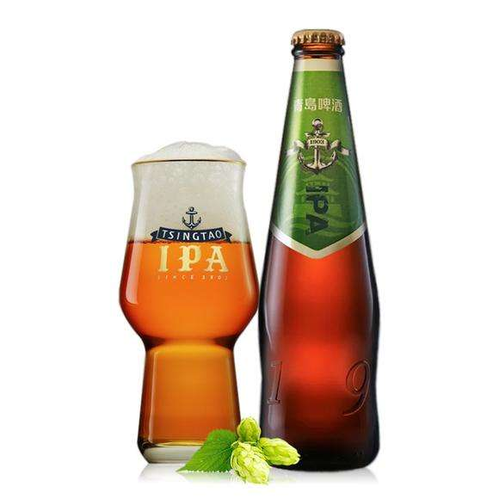
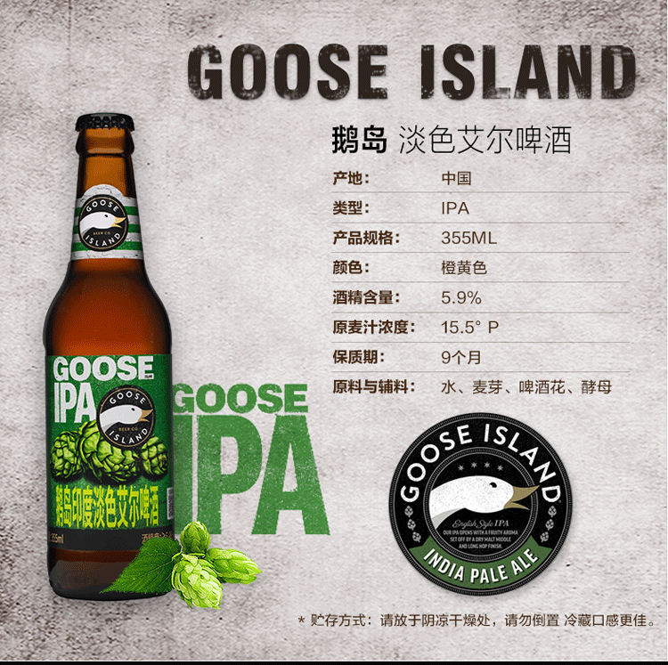
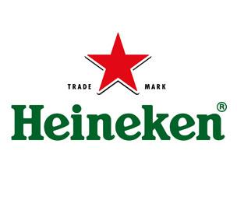

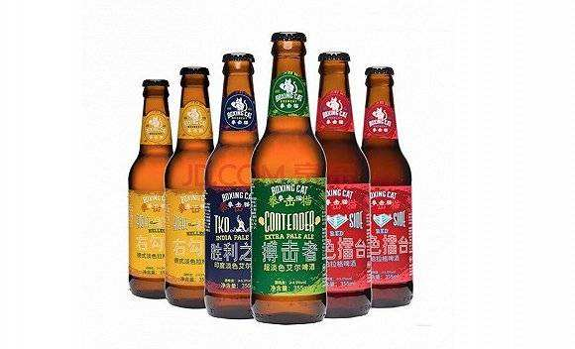

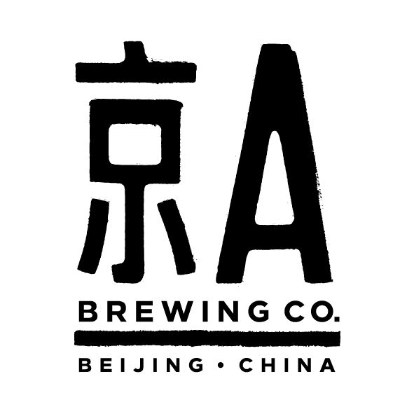
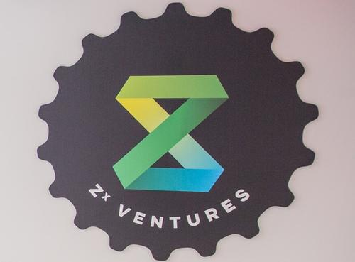
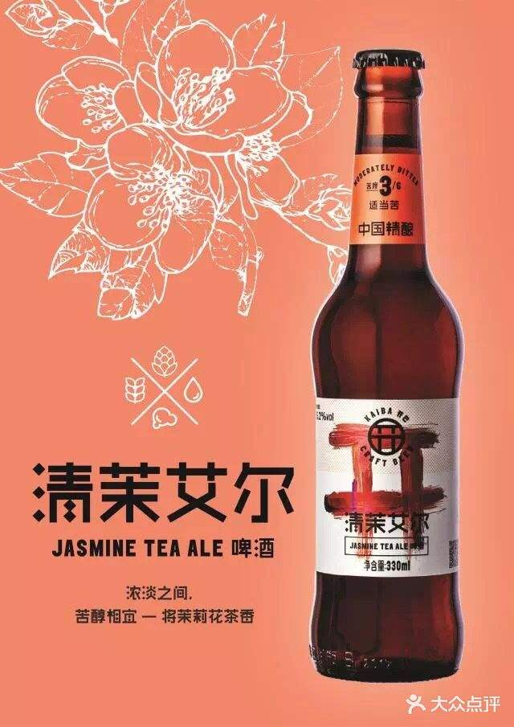
Market Overview
-Craft Beer Movement

Slide 11
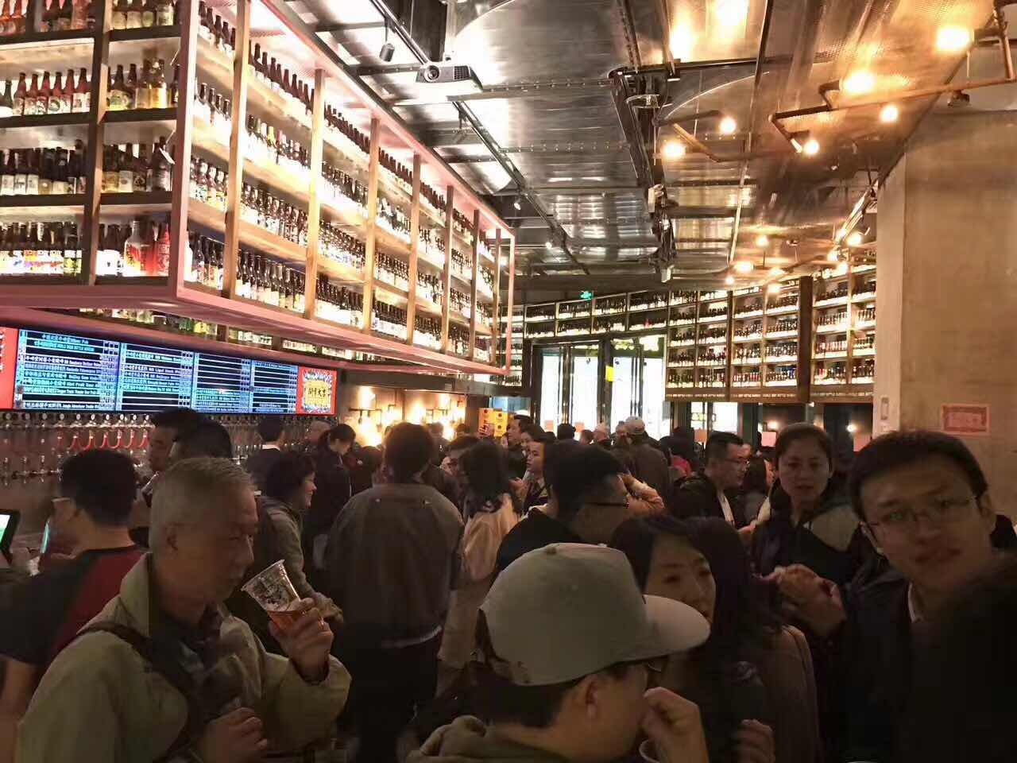
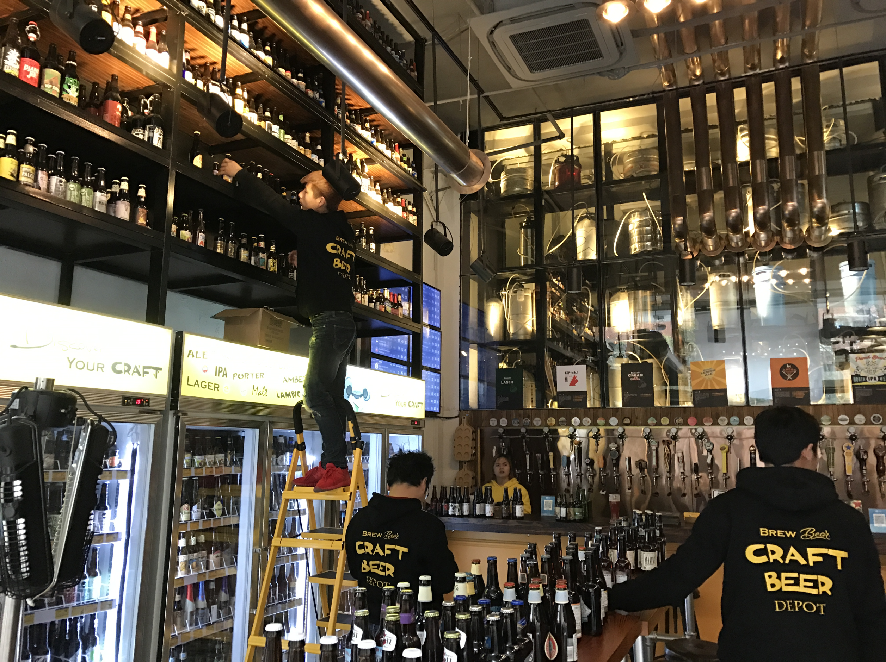
Market Overview
-Craft Beer Movement
Local Craft Beer Bars

Slide 12
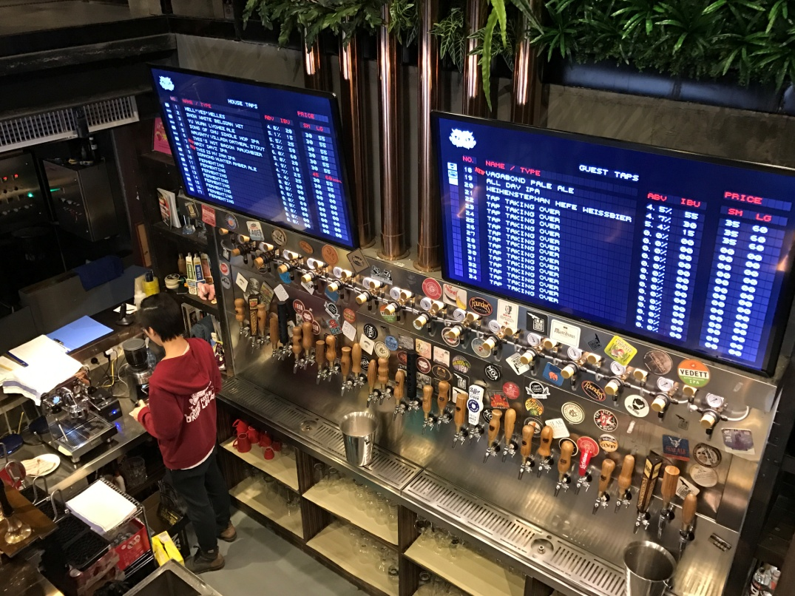
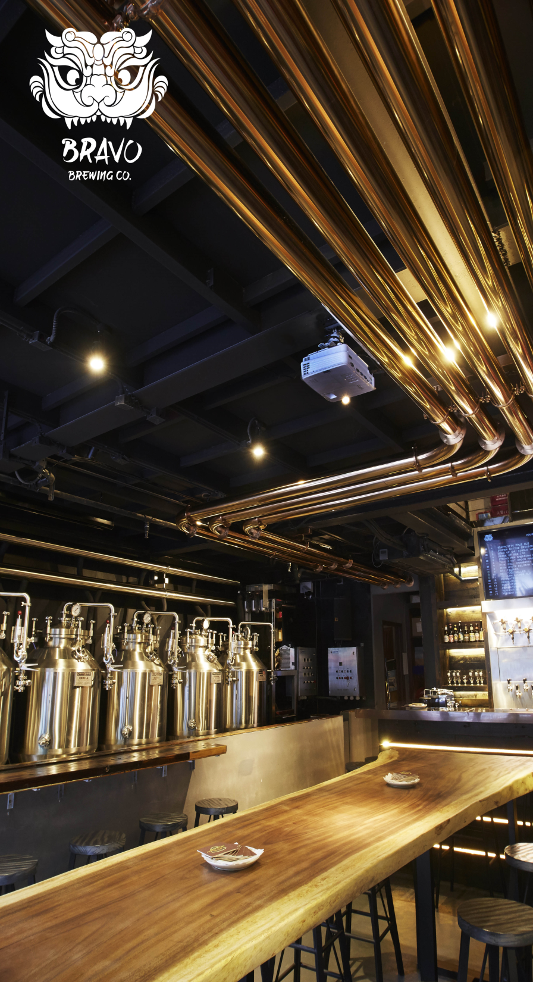
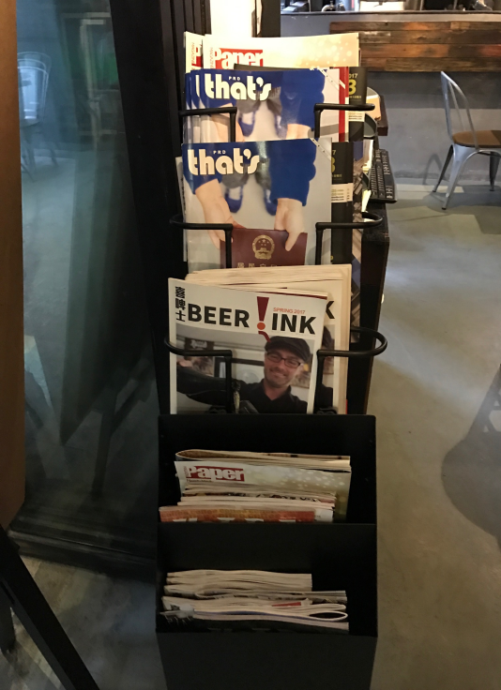
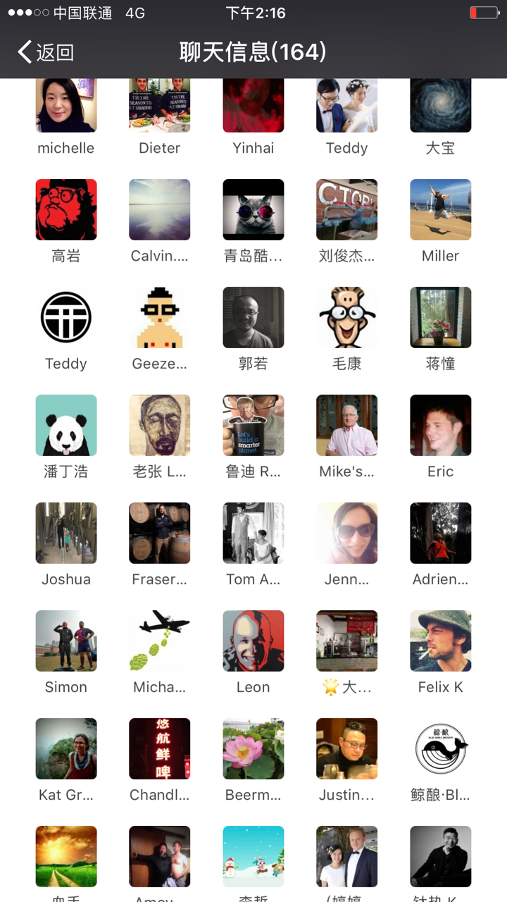
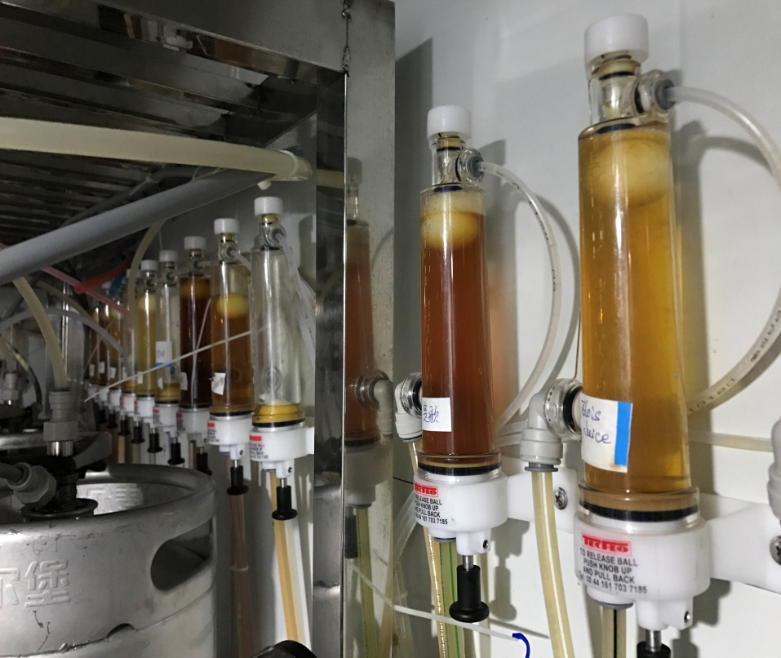

Slide 13
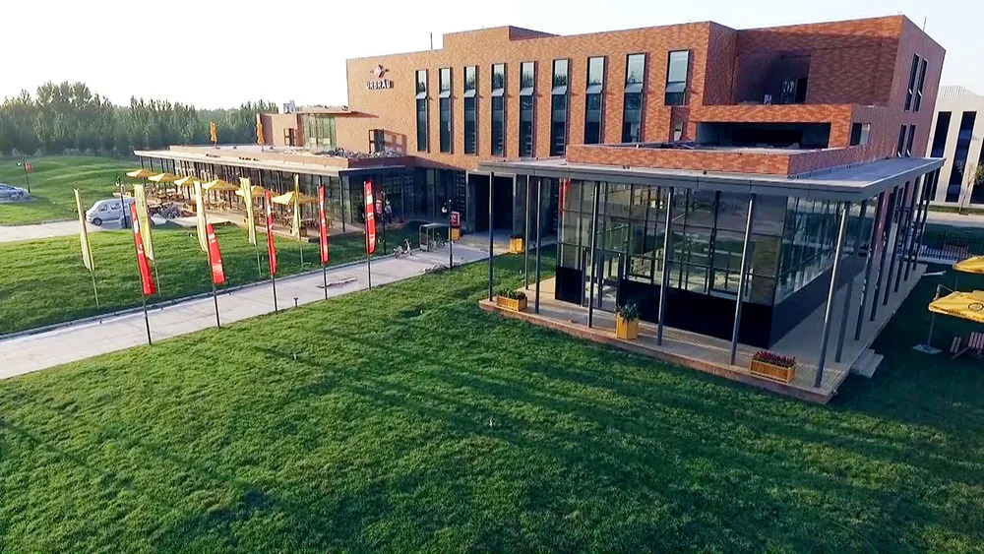
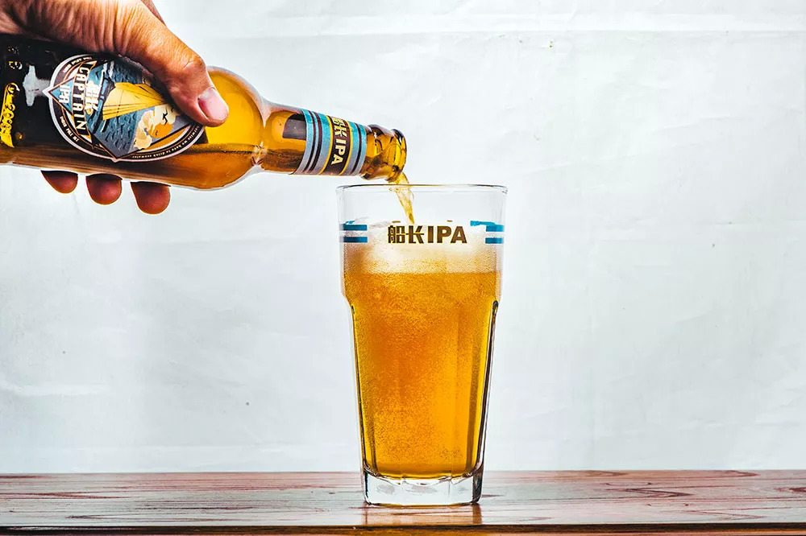
Local Craft Brewery with Capacity of 30,000 Tons (Own Brand + Contract Brew)

Slide 14
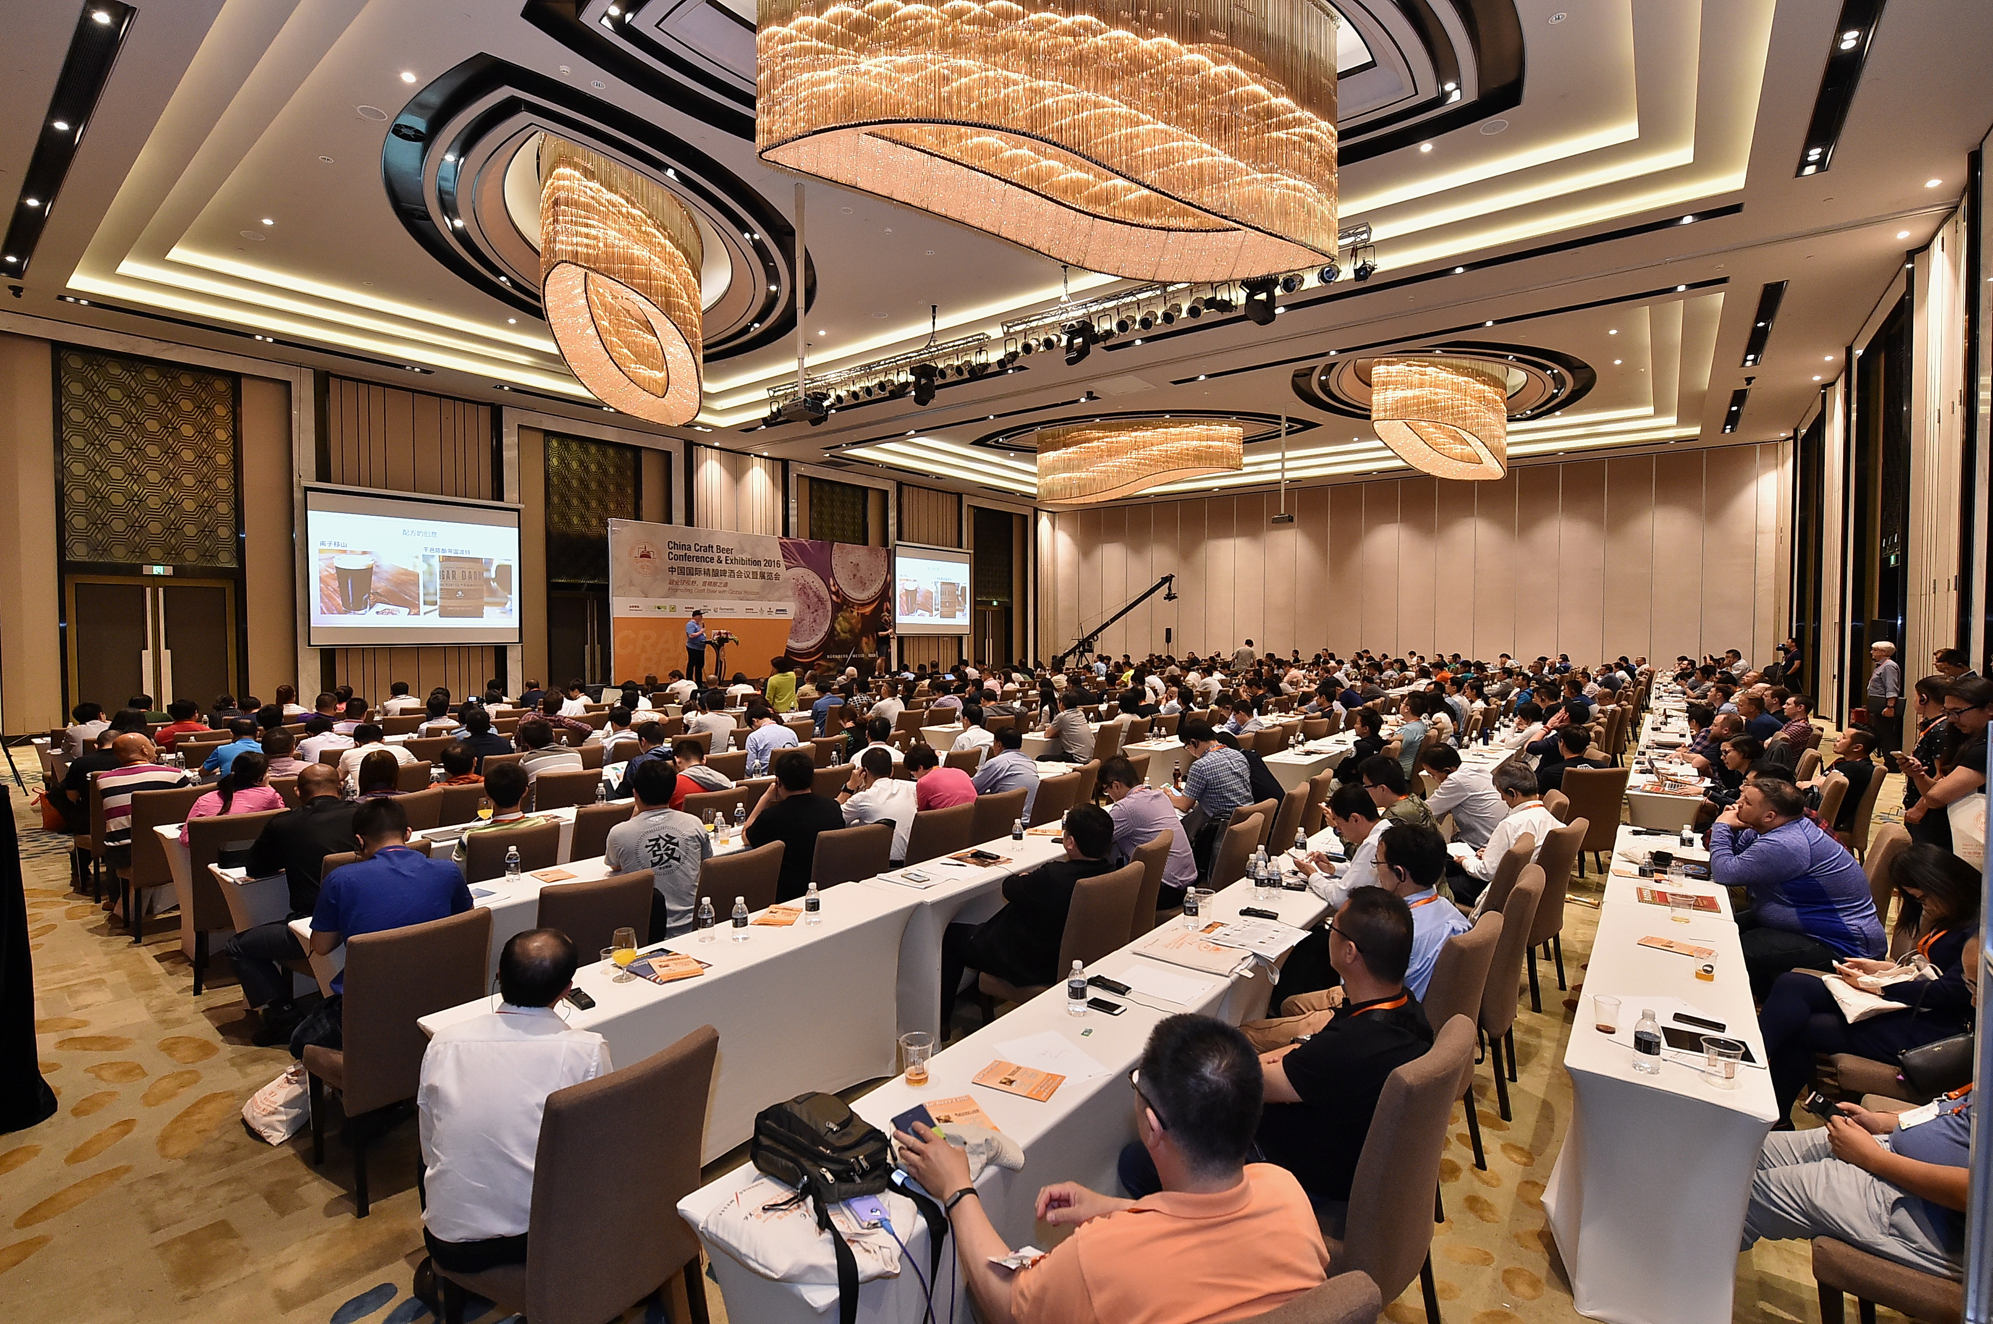
China Craft Beer Conference & Exhibition:
40 + International Speakers
680 Attendants，5000 visitors
100 boothes
www.cbcechina.com.en

Slide 15
Market Overview
-Important Policy
取消限制：
2019年4月8日，国家发展改革委员会同有关部门对《产业结构调整目录（2011年本）（修正）》进行了修订，形成了《产业结构调整目录（2019本，征求意见稿）》。《征求意见稿》取消了“生产能力小于18000瓶/小时以下的啤酒灌装生产线”（属限制类）和“生产能力12000瓶/小时以下的玻璃瓶啤酒灌装生产线”（属淘汰类）的规定。
Bottling Licence: 18000 Bottles/ Hour ?

Slide 16
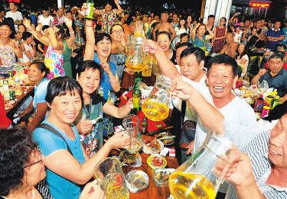
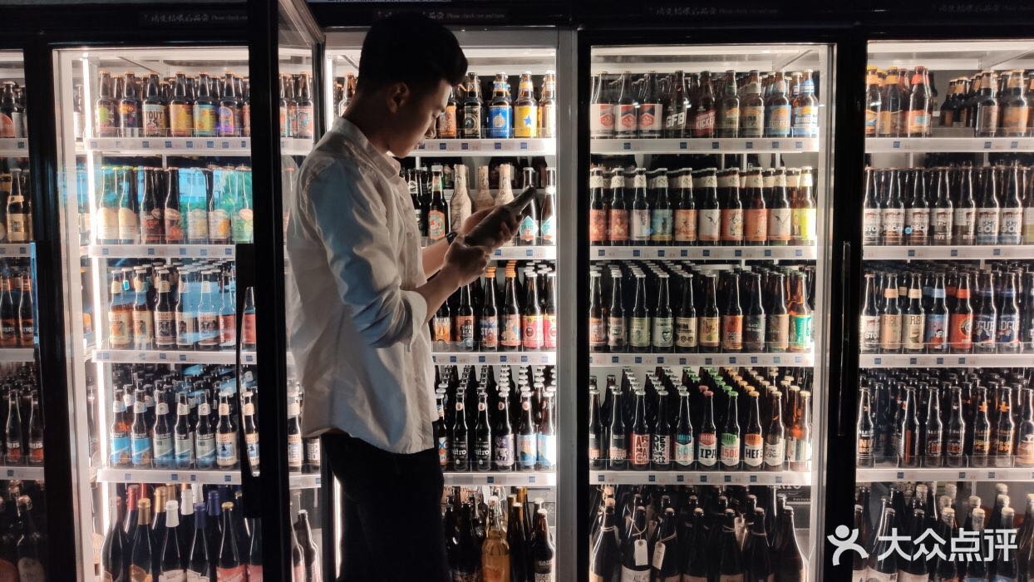
Trends
-Consumer Trends
Massive Market
Niche Market
Beer & Food pairing is huge, drink & eat always together
Bitterness /sourness = bad quality
Light, refreshing beer & wheat beer is popular
(strong aroma/malty/fragrance = Good beer)
Heavily influenced by Germans, Beers from Germany = top quality
Drink for ganbei( = bottoms up) but not for the appreciation of taste/flavors
Consumption upgrading stage- Drink more toward Drink Better
Confident and proud in products that made in China
Growing population of returned students/ Expats
Consumers are getting well-educated, sick of main stream tastless beer and growing demand of different styles of beers
Appearance of female drinkers- start from fruit beers
Drinking craft beer is cool & fashion
Drink for the better taste of the beer and emotional resonance
Notes:
中国年轻消费者受过好的教育，出过国或者在大城市有更高的视野，他们对不像父辈或祖父辈那样而是对中国自己的东西，开始重拾中国传统文化，穿汉服，背古诗，将民族文化融入不同的行业中。所以中国本土精酿在酒吧卖的非常好。

Slide 17
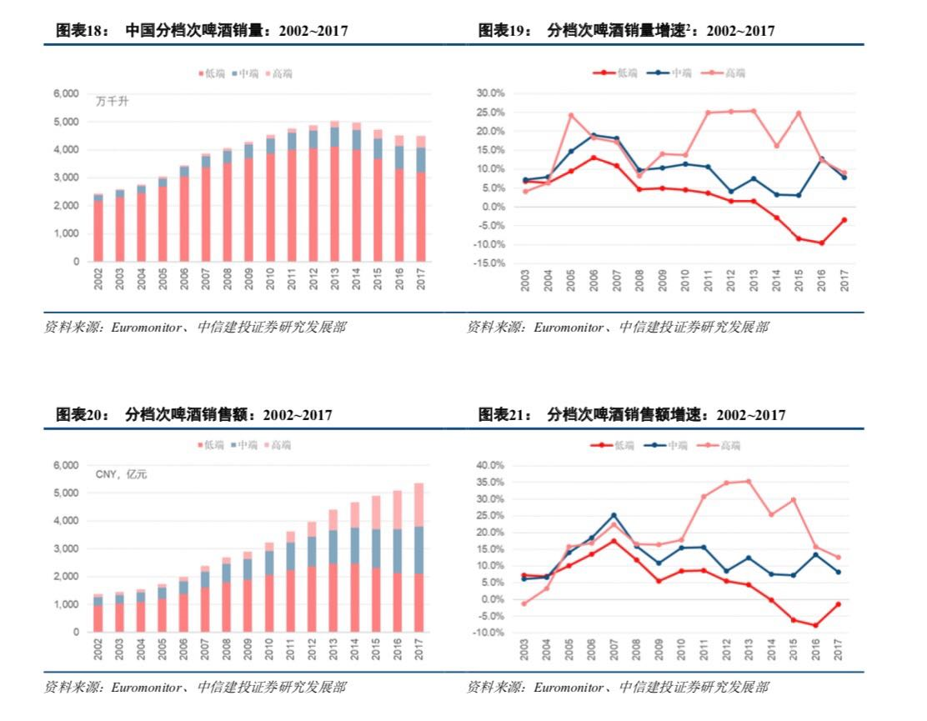
Trends
-Product Trends
> 14 RMB
7-14RMB
< 7 RMB
Notes:
说一下从拉格，到德式、比利时小麦的流行，到现在IPA, 世涛开始，到中国精酿开始运用本土原材料酿酒。这里包括青稞啤酒。

Slide 18
Trends
-Channel Trends
Traditional Distriution System
On Premises (80%)
(Restaurant, Bars, KTVs...)
Off Premises:
(Supermarket are keep closing )
Layers from 1st to 6 tier cities
Distributors call themself : Bricks Mover
Traditional Distribution + Direct and Online Sales
Depending on the importers distribution system (Selected high end restaurants\bars\ supermarkets)
Some will have direct sales team in key cities and sell directly to the bars and restaurants as competition is fierce
Some opened the online malls at the key online platforms ( JD, Tmall)
Majority are drafts
Taprooms, Bars,restaurants...
Easy CS License unless contract brew ( 10 tons up)
Brewpub Franchise
Sell at own brewpubs
Customization
Customize for franchised restaurants/bars/hotels
(Haidilao, Hellis)
Customize for online platform
(Hema & Reberg, Yangcun & JD）
Customize for Companies
Online/ New Retailing/ Intelligent Retailing
5G
30 Minutes to the door delivery
Massive Market
Local Crafts
Trend
Imported

Slide 19
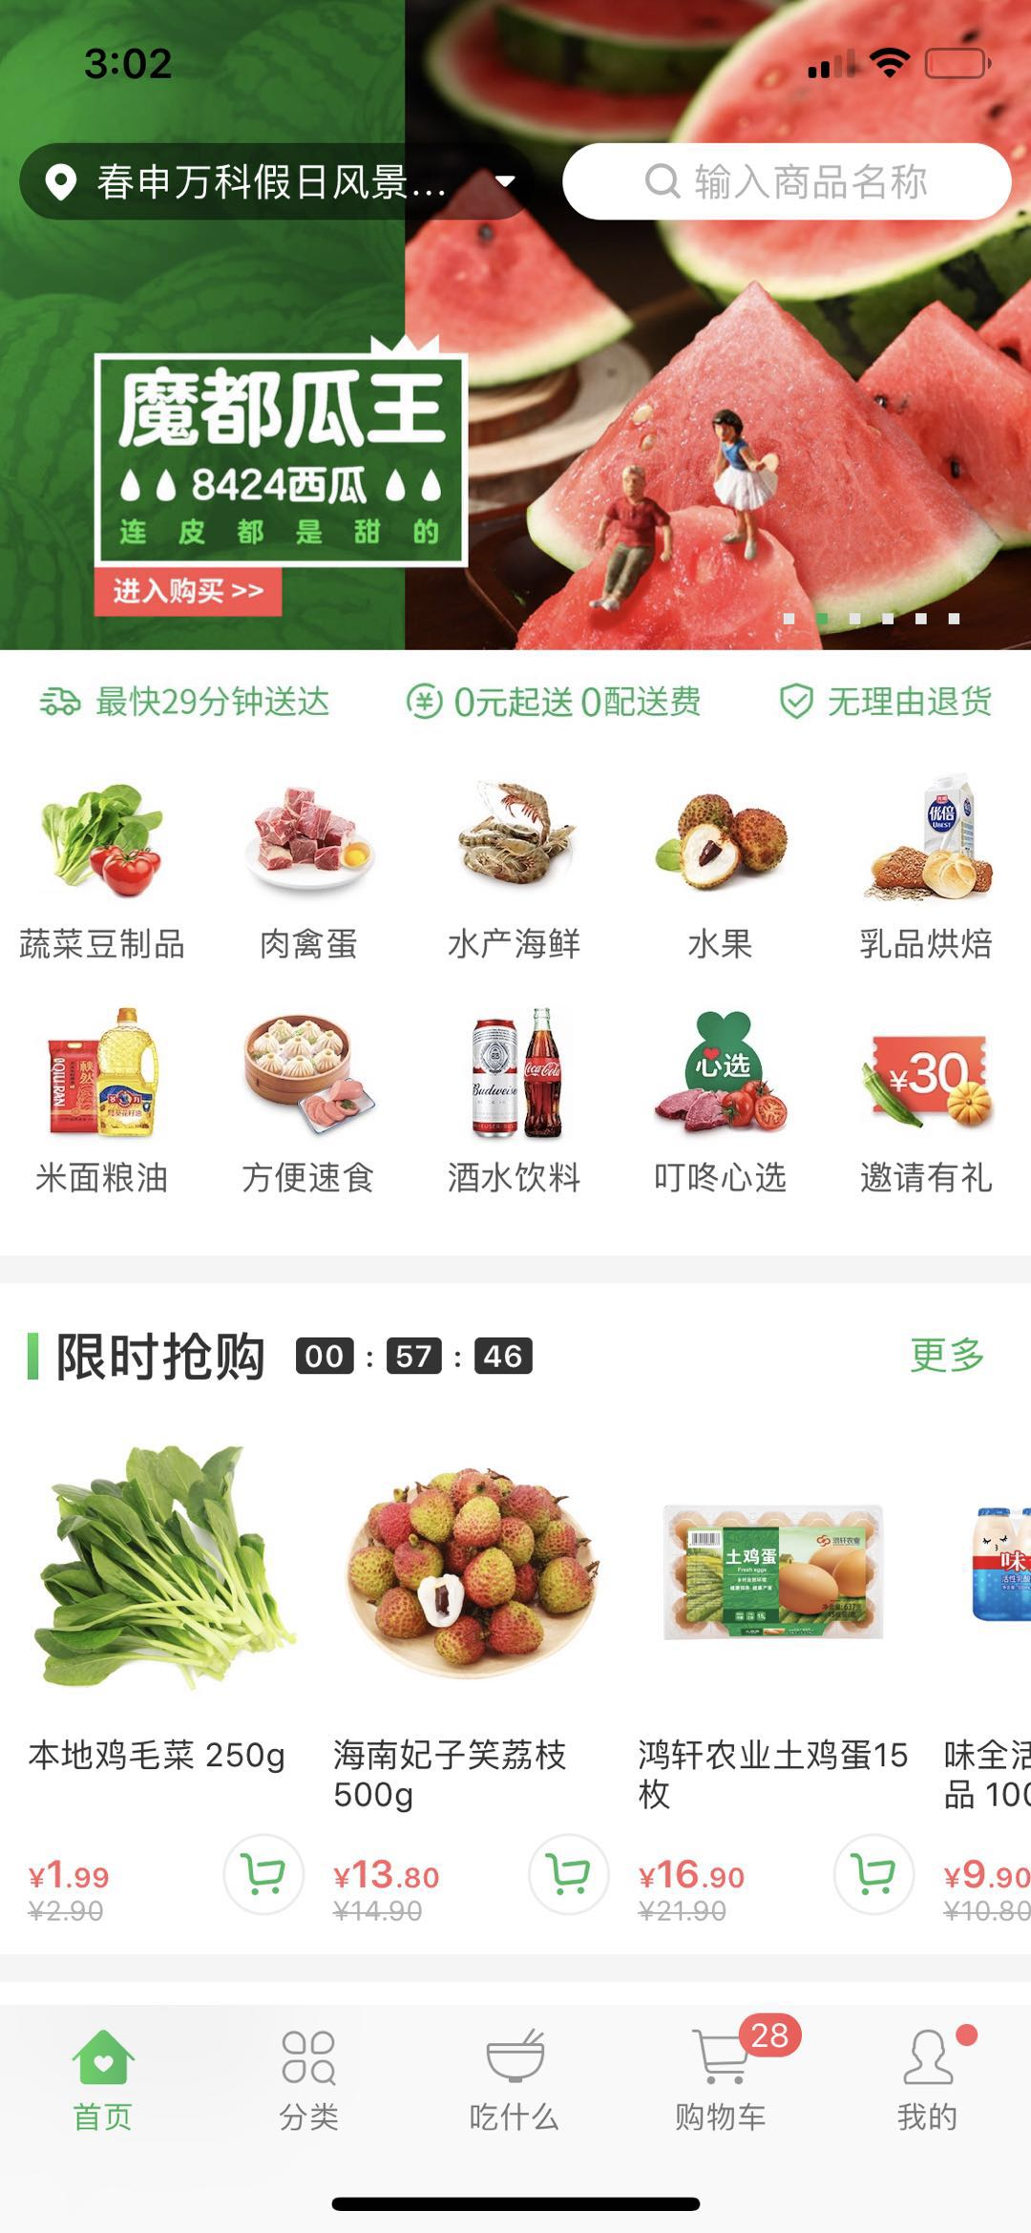
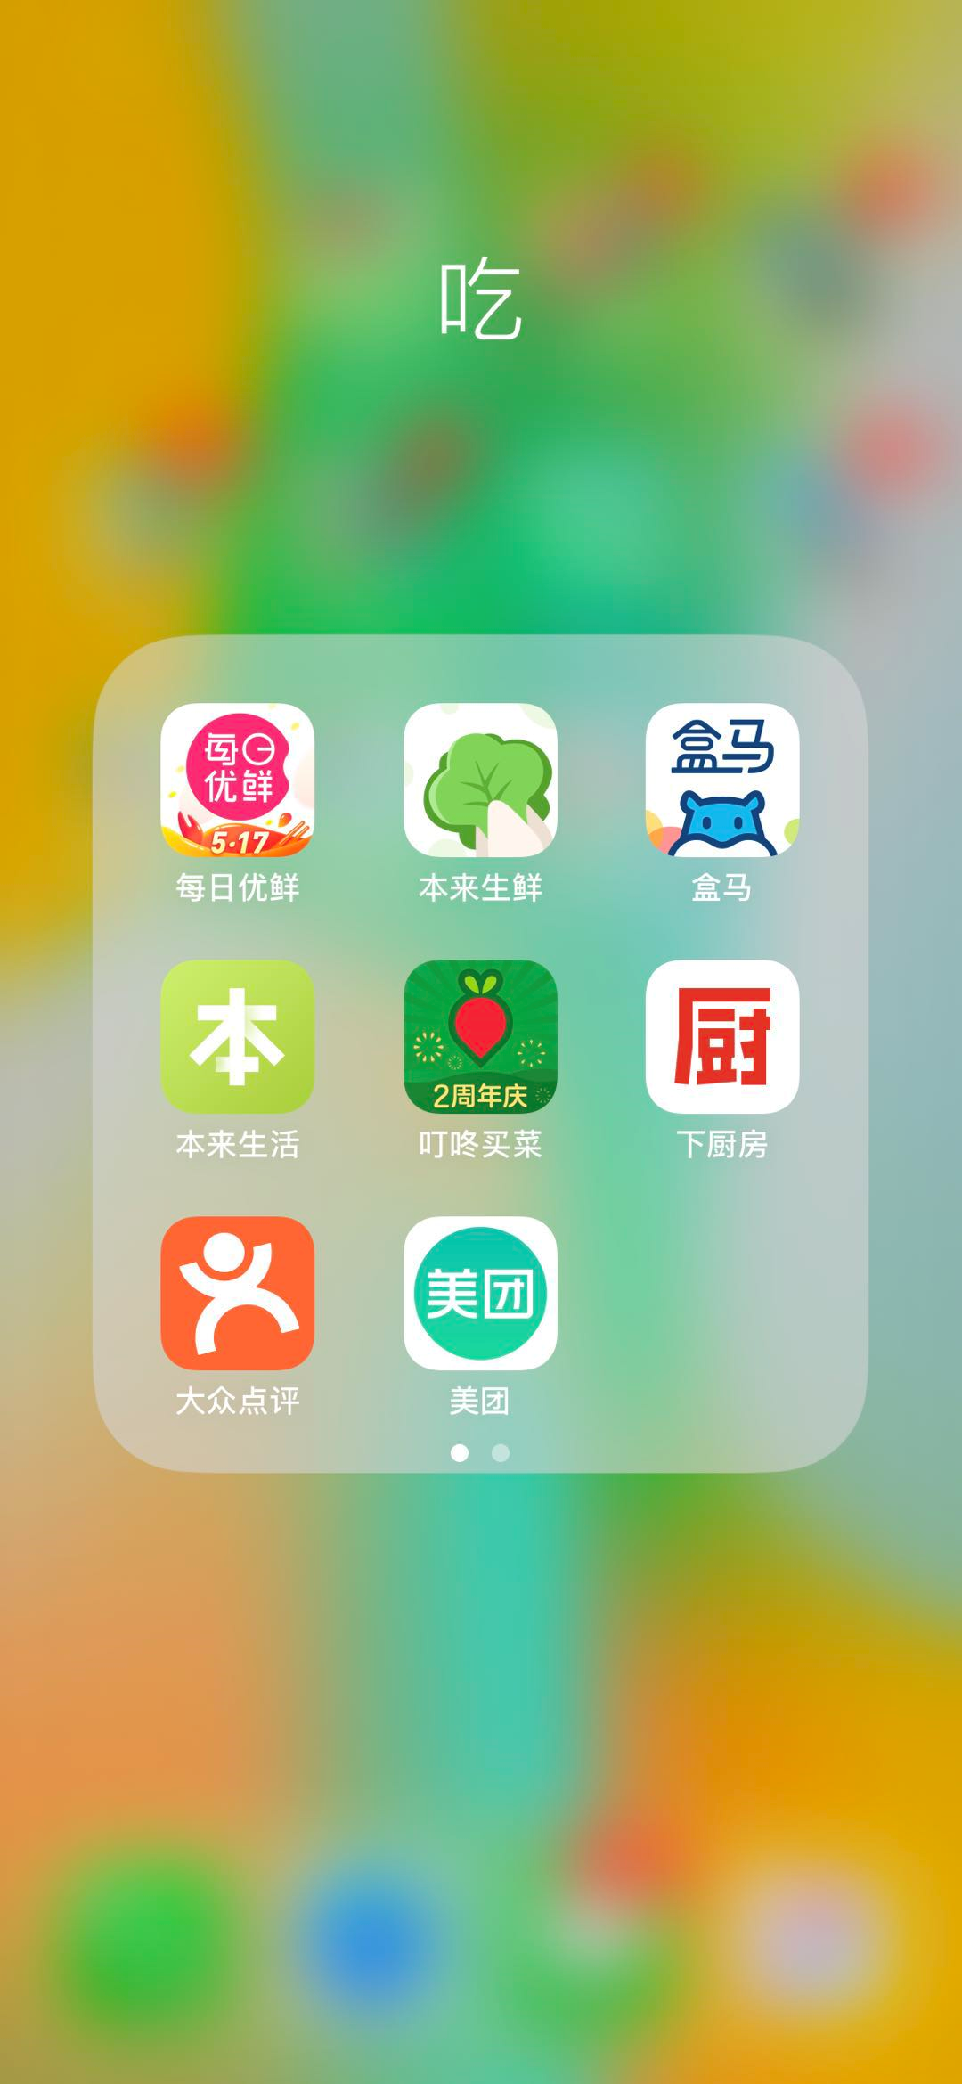
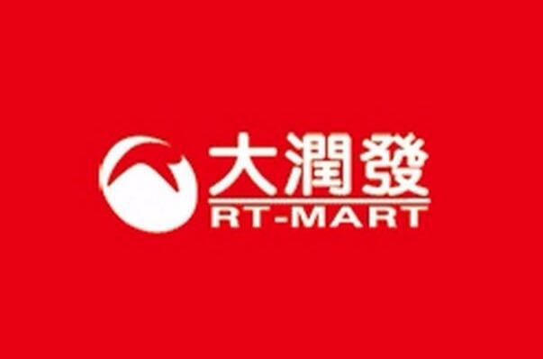
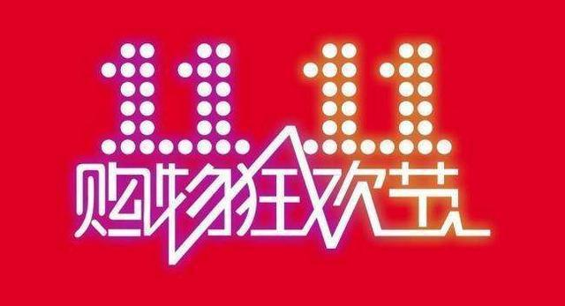
Trends
-Channel Trends
China 2017 Online User No:
0.772 Billion People
China 2017 Online Shopper:
0.533 Billion People
69.1% of the taotal online users
14.3% increasing than 2016
China 2017 Online Retail:
7180 Billion RMB Sales
39.17% incresing than 2016
19.6% of the total retail sales
213.5 Billion RMB
Notes:
河马海鲜新模式，宝燕。大润发，我打败了所有竞争对手，却输给了时代。

Slide 20

Jack Ma:
Pure E-commerce will die, New Retailing is coming! Revolution is far beyond our imagination.
What is new retailing?
Notes:
今年是2018年即将步入19年，各界网联网大佬们在这两年中纷纷改变销售策略，都想要借一把新零售的东风。
例如小米公司的雷军说过，新零售就是提高效率。然后说自己的米家已经做到了线上线下结合。其实米家就是小米的商城而已，需要线上购买的依旧是依靠网络交易然后快递送达用户手里，线下购买的也是跑到米家门店选购，我认为这不算什么新零售。
京东2017年推出的百万便利店计划，刘强东说京东的便利店要开遍中国所有的乡村，这个我都觉得有点好笑。先不说他要垄断中国便利店，时至今年，很多地方的京东便利店也没有门庭若市，而且跟普通的便利店区别不大。还有直接刷脸支付的无人超市。。。

Slide 21
Opportunities-Exporting
-Challenges by Exporting Model
01
Freshness – due to pasteurized process/ time on Sea shipping and local land distributing from importer
04
Fierce competition nowadays as massive breweries around the world are targeting China as their primary market
02
Parallel shipment & grey market – disrupting price system, damage quality & brand
05
Some overseas craft breweries start opeerating in China directly
Challenges
06
Importers are not encouraged to spend money on brand building (Cases: Paulaner, Hoeegarden, Red Bull etc. )
03
Higher Price compared to local crafts
Notes:
第一个机会，exporting

Slide 22
Opportunities
-Cooperate with Locals
Consumption Upgrading
Consumers needs better quality and more styles
No Leading craft brand yet
Everyone is now at the same starting point
Who will be the leading Chinese craft beer players in 10 years?
Notes:
国际品牌的历史背景，国际化的视野和创意、管理经验、酿酒技术 结合本土团队对本土消费者，市场和渠道的了解共同打造合作品牌。 1. 不一定是国际品牌，可以是合作的新品牌， 因为中国年年轻消费者对国货已经不像父辈那样了。

Slide 23

THANKS
Email: michellewang718@126.com
michelle@thebeerlink.com
Mobile: +86 18601790116

