Slide 1
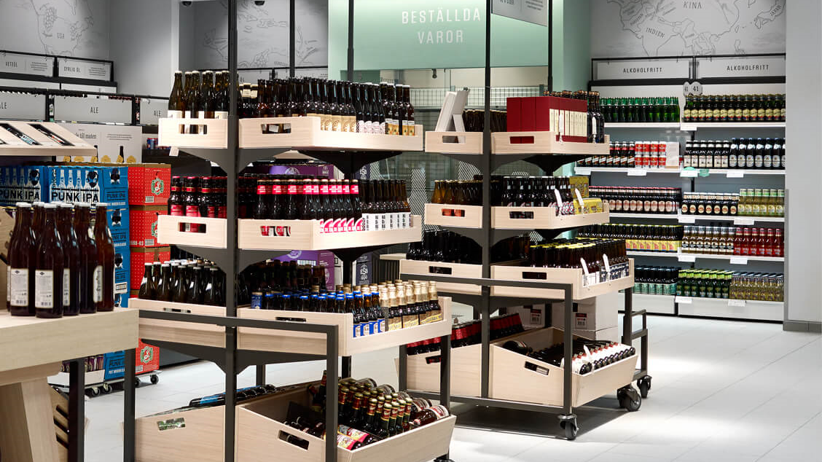
Beer in Sweden:
How to get distributed in the Swedish alcohol retail monopoly
Johan Ahlstedt, Purchaser
Märta Kuylenstierna, Category Manager

Slide 2
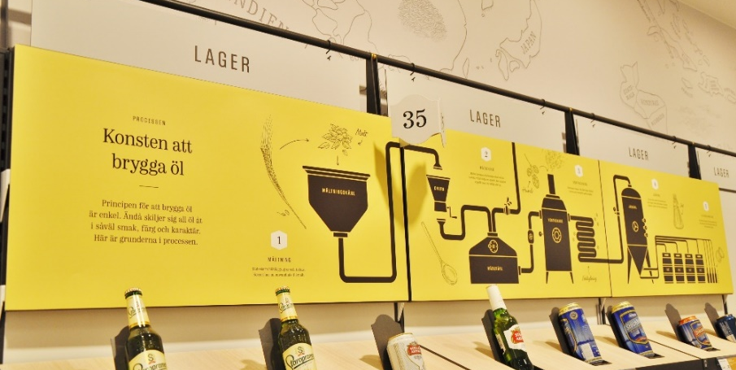
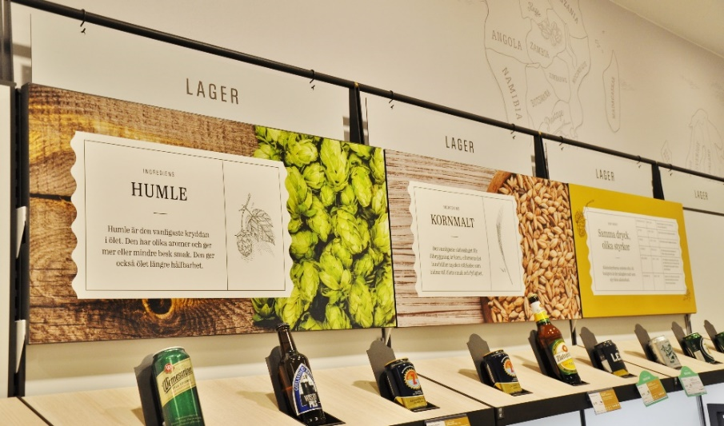
Agenda
Sweden in brief
Systembolaget in brief
Beer trends in Sweden
Purchasing process
How to sell to Systembolaget
Notes:
Sweden in brief– Märta
Systembolaget in brief – Märta
Beer trends in Sweden – Märta
How to sell to Systembolaget - Johan
Distribution
(Labeling requirements)
Opportunities for market development

Slide 3
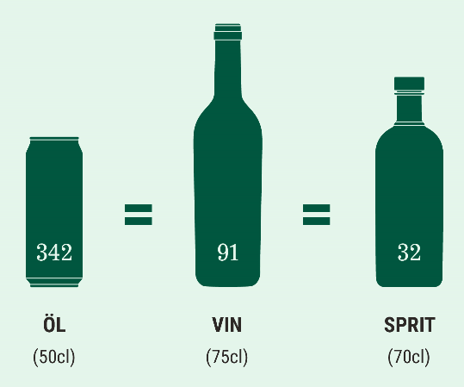
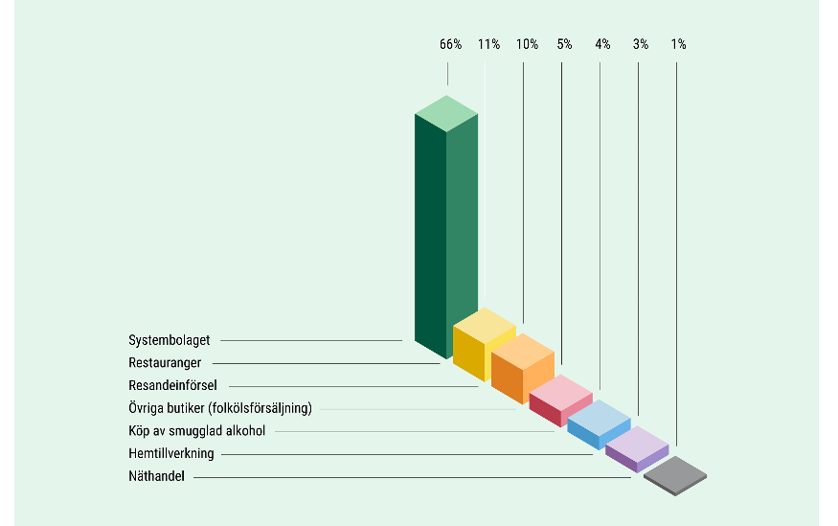
Sweden in brief
Average consumption in Sweden (2018)
Population: 10 millions (+1,5%).
Area: 447.000 km² of which 260.000 km² is forest
Second lowest population per square kilometer in all of Europe.
86% of the Swedes live in cities
Total consumption: 9 litres of pure alcohol / year (above 15 years). Lower than the average in Europe.
Young adults drink less than before.
From beer to spirits to wine to beer again.
Notes:
Total Population: 9 995 000 (2017)
2/3 of Sweden’s land area is covered by forest
The fifth biggest country in Europe (in terms of area)
The total land area is 447 435 km² m but despite that, Sweden has the second lowest population per square kilometer in all of Europe.

Slide 4
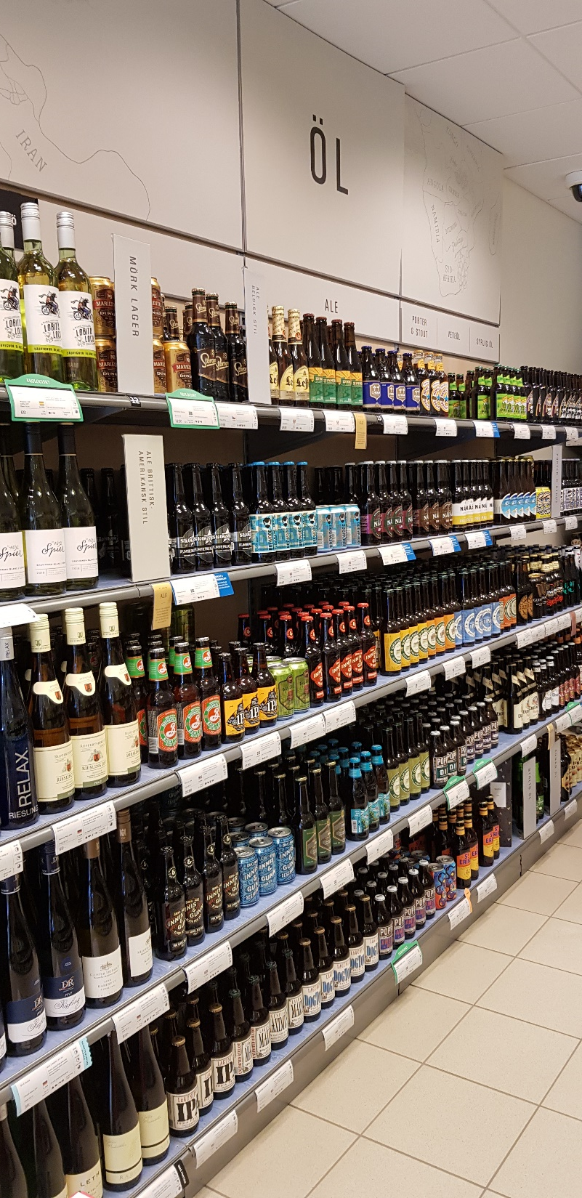
Systembolaget in brief
Approx.
440 stores and 500 agents in smaller towns and rural areas
125 million customer visits to our stores
52 million visits via digital channels
700 active drinks suppliers
16 000 products of which 2 400 in the fixed range
No maximisation of profits or additional sales
No discount or store promotion
Brand neutrality
Responsible approach and good customer service
When it comes to beer:
250 000 000 liters of beer = 50% of total volume / 24% of total value.
+6,1% (total sales +4,5%)
Notes:
To reduce the harmful effects of alcohol. By taxes (Swedish tax authorities) and by availability (SB)

Slide 5
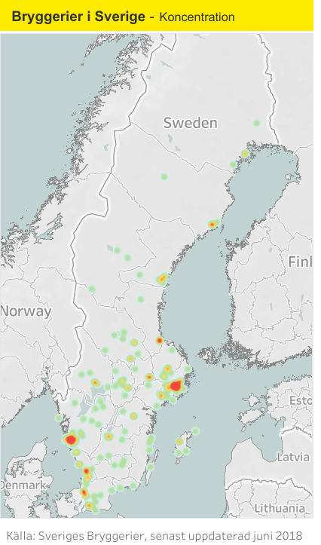
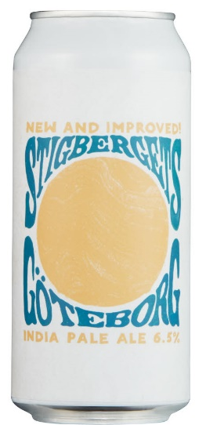
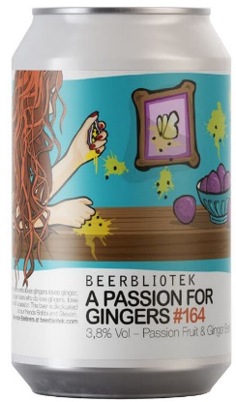
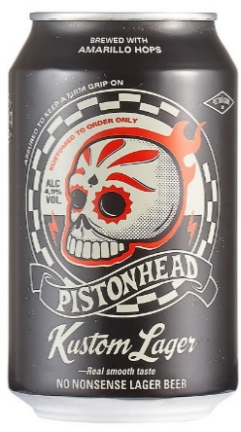


Beer trends in Sweden
Sustainability –organic & packaging
Local
IPA & the return of the lager
Notes:
Numerous trends.
33 breweries per million inhabitants. As far as we know: ett av världens mest bryggeritäta länder.
From 10 breweries 10 years ago to 340 2018.

Slide 6
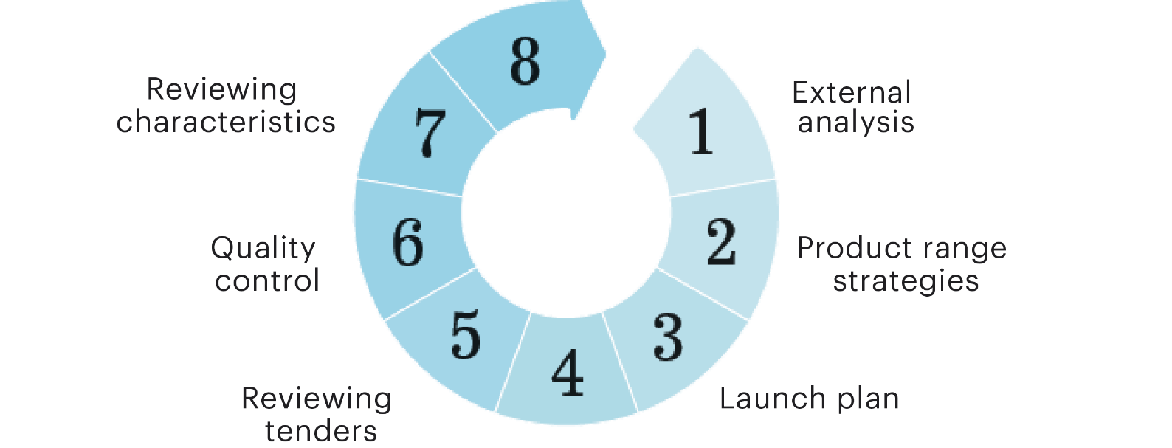
Purchasing – a quality assured process
Notes:
We want to ensure that the products our customers buy are of the best possible quality and that they can always feel safe with the products they buy from Systembolaget. Numerous suppliers are given the opportunity, based on the requests for tender that we send out, to compete in the blind tastings that ultimately determine the products we buy in and display on our shelves. The competition is tough and it is important to us that our suppliers can rest assured that the product that won the blind tasting did so on a level playing field. Our purchasing process is a transparent one in which all suppliers, producers and brands are treated the same – one of the most important principles of Systembolaget’s operations. Every year, Systembolaget produces a launch plan that determines the types of drinks we will be looking for in our requests for tender.
1-3. The launch plans are based on external analyses and overall offering strategies.
4. We then issue a request for tender to drinks suppliers for each launch, specifying the types of drinks for which we are looking. Interested suppliers respond to the request for tender, after which we process all of the responses.
5. We then, based on the tenders, request product samples that are blind tasted by a tasting panel that reviews all of the drinks tendered.
6. The next step is a comprehensive quality control process in which we carry out chemical analyses of the drinks in our own laboratory.
7. Before being launched in the stores, the drinks are tested again, both by a tasting panel and in the laboratory. This is to ensure that the drink delivered to us is genuinely of the same quality and tastes the same as the one that won the blind tasting (point 5). This is when the drink is assigned its taste description that will be displayed on the shelves in store and on the systembolaget.se website.
8. The drinks are ready to go on sale.

Slide 7
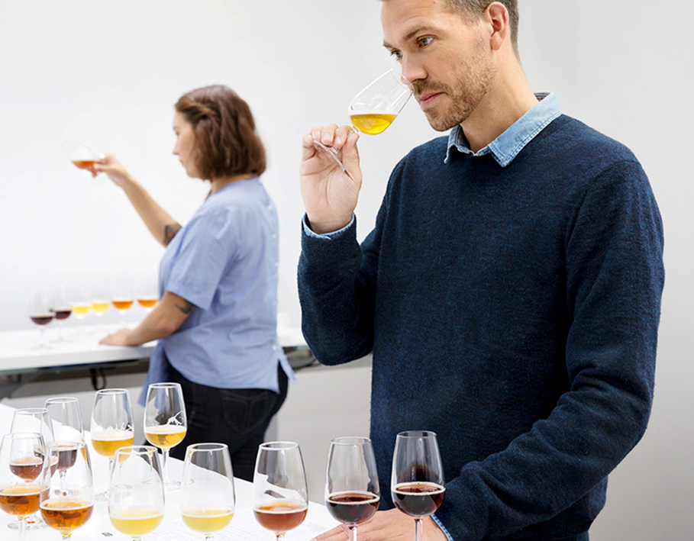
Tender tasting
Three tasters per session
Purchaser present - if no. of products exceeds four
Introduction
Blind tasting – no discussion
1st requirement – must match the taste profile
2nd requirement – quality
Scores are awarded to each product
Decision based only on sensoric tasting
Winner will be launched and gets a 9 or 12 months listing
Notes:
Offertprovning

Slide 8
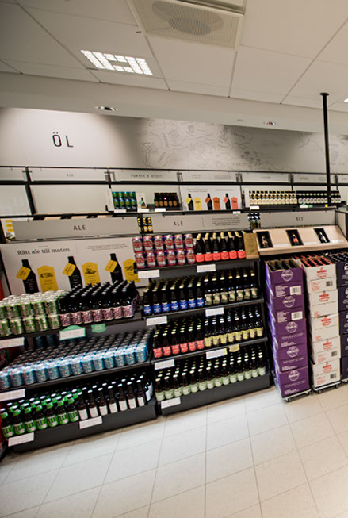
What to know
Systembolaget buy through importers
As a foreign producer/ supplier you need an importer or be registered with Swedish tax authorities
Distribution/ warehousing needed as Systembolaget buy free delivered to each store
Sales statistics available on monthly basis
Systembolaget mark up is transparent
Notes:
Almost 1200 registered suppliers, 795 active

Slide 9
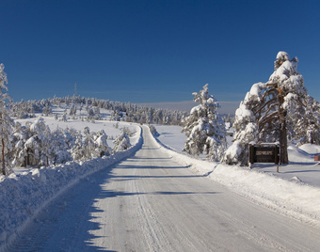
Central distribution to whole country
Two depots deliver customer-unique orders
Stores may order items from entire product range
No cold storage in stores, but cold transport 6 months a year..
Notes:
Our 2-depot distribution system gives customers access to a bigger range than they have had via the agent store. So basically as a customer you have access to the whole ordering assortment and fixed assortment that is not available in your store – for free.
We get a few questions about if we have cold storage in store – we havn’t. Mainly because since we are brand neutral we would have to have all our beers stored cold and that would also probably increase the immediate consumption of the alcohol which is against our mission.
However, since we are a Nordic country we naturally have cold transport 6 months a year…

