Slide 1
The Beer Sommelier Education Program
A necessity for the brewing industry
1
Dr. Michael Zepf

Slide 2
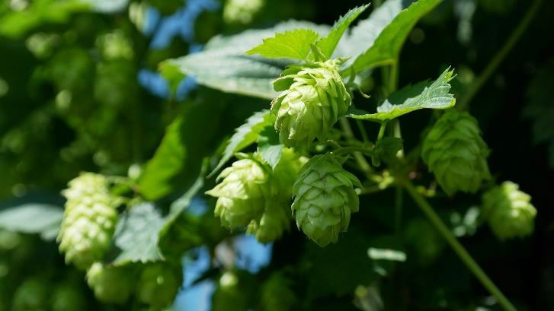
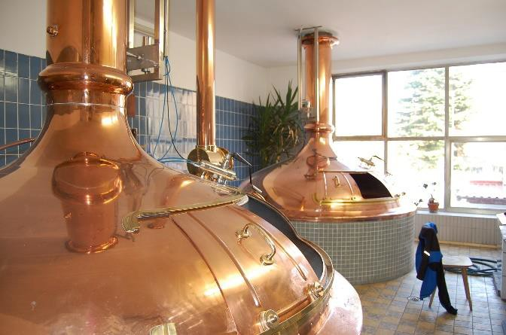
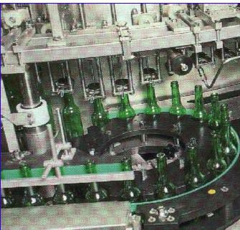
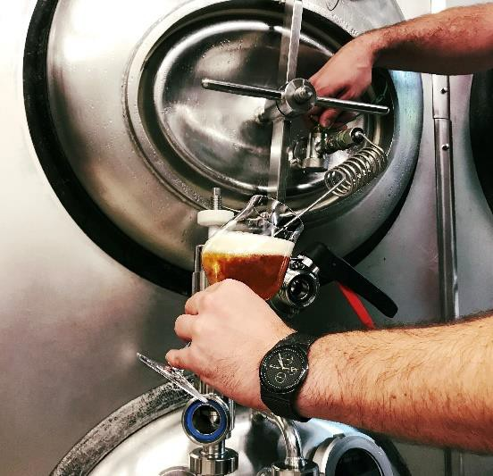
Question: How many measures of quality control do you take
during the brewing process?
2

Slide 3
Some provocative questions…
What quality controls will take place after the beer has left the brewery?
What knowledge of beer and its quality does the customer have?
What direct contact does a brewery have with its customers?
Why does the customer buy your beer?
2

Slide 4
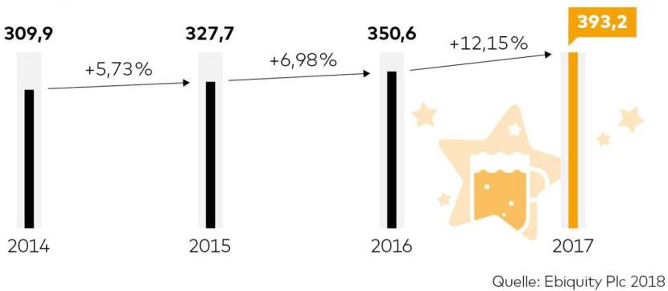
The shop windows for a brewery presenting their products:
Advertisting (e.g. print media, television, social media, sponsoring…)
Effectiveness?
Trade (supermarkets, beverage markets, beer stores)
Influence of the brewery?
Gastronomy (restaurants, bars)
➢ The hope that everything goes well ...
4

Slide 5
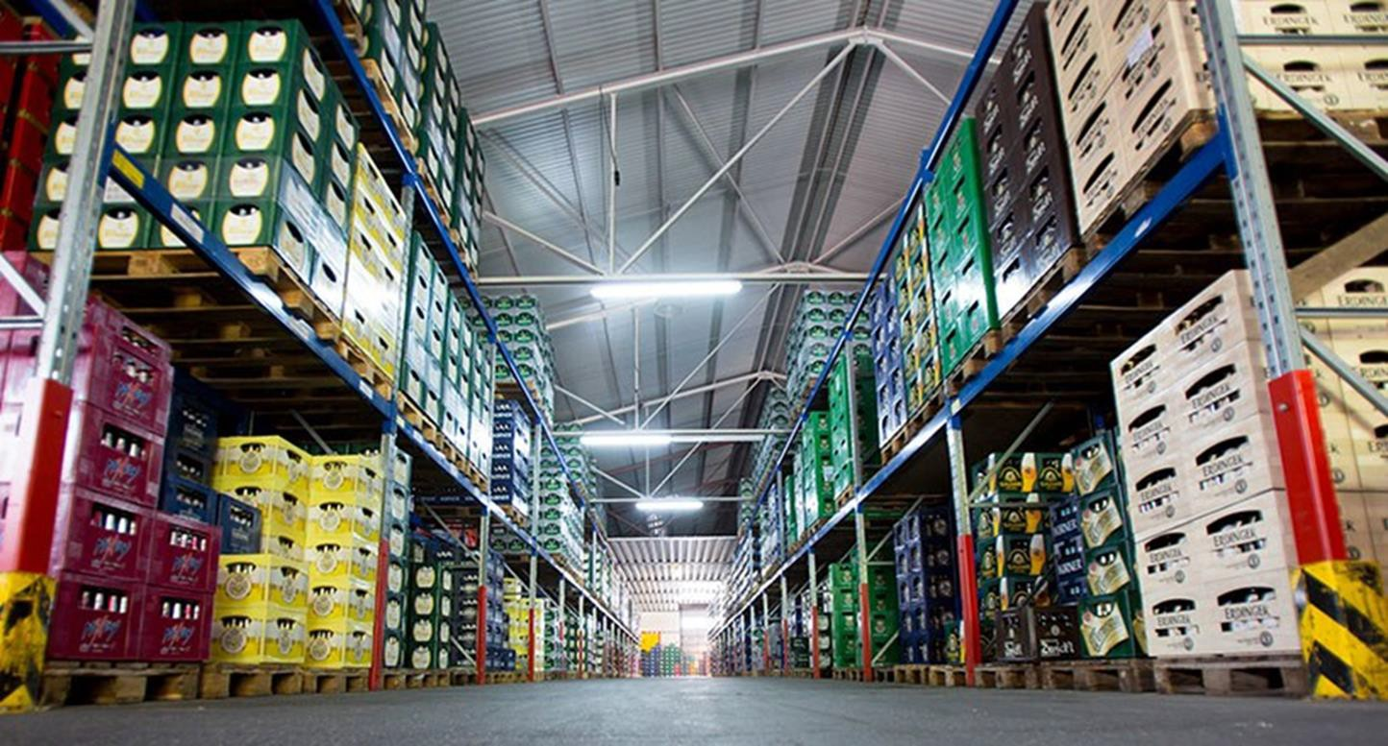
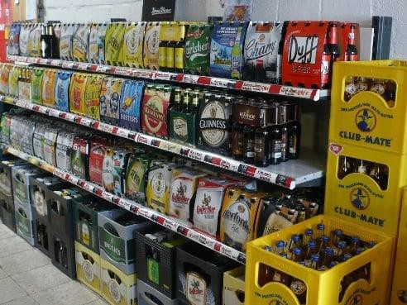
Trade
What picture of beer does the customer see during shopping?
Brand loyalty? Why?

Slide 6
Trade as brewery/customer interface
Current state:
Beer is sold predominantly in the trade
No real chance for building a positive image and create brand awareness
Purchase decisions are increasingly determined by convenience: "one- stop-shop" (buyers want to buy as many goods as possible in one place)
Purchase decisions are heavily influenced by the price: More than 70% of the beer is sold in sales promotion
Problem of maintaining the beer quality!
Demand for education and training of the trade staff

Slide 7
Gastronomy as brewery/customer interface
Big chance for image building!
Customer has time and is more open to be confronted with beer brands
Visiting the gastronomy sector has a positive tenor: treating yourself, meeting people, fun
The special experience: the combination of beer and food
Easy for brewery to tie in a positive brand message
BUT: Risk for a negative experience (service, draft system, glass ware….)
Demand for education and training of the gastronomy staff

Slide 8
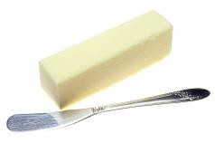
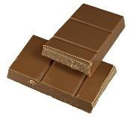
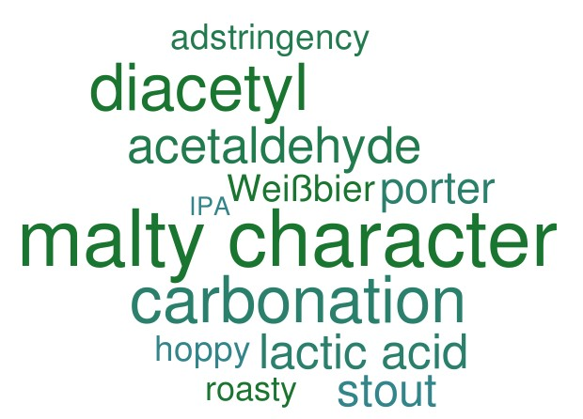
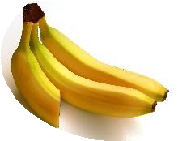



Beer Sommelier as…
Translator

Slide 9
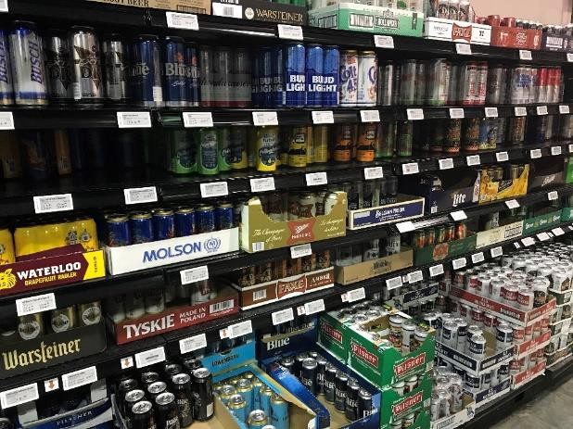
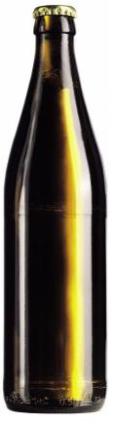
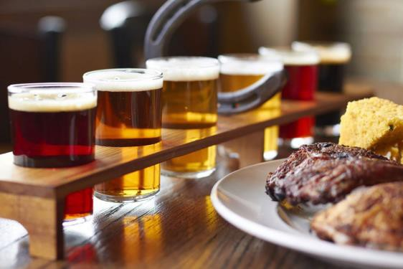
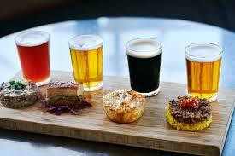
Beer Sommelier as…
Navigator
A
B
C

Slide 10
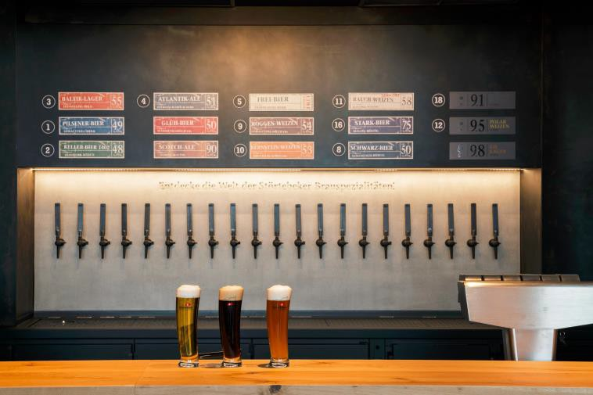
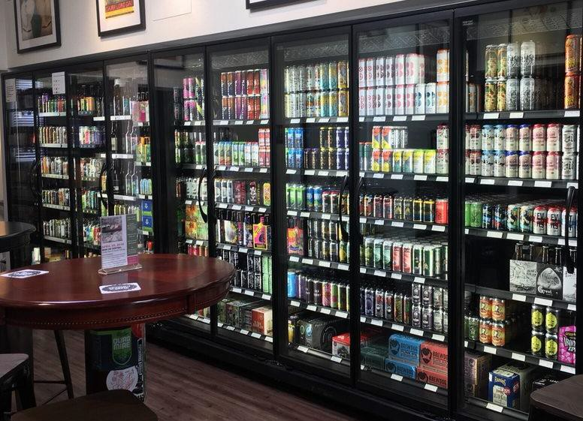
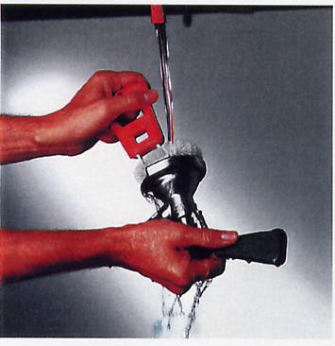
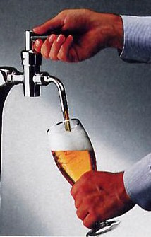
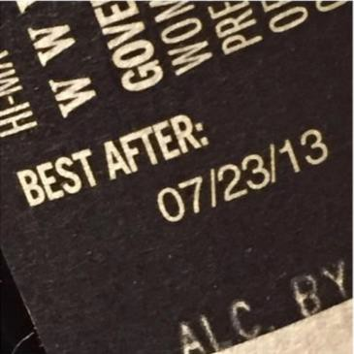
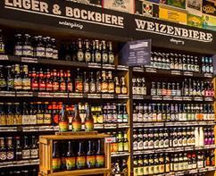
Beer Sommelier as…
Guardian of high beer quality

Slide 11
The role of a Beer Sommelier in the trade sector
Selection of beers for the market (shelf life, demand, diversity of styles)
Ambassador for beer → Bridge between Customer and Brewery
Implementation of proper storage conditions for beer
Knowledge about the different beer styles
Character, flavour
Sensitivity to aging
Reasonable advice regarding customer expectations
Education and training of colleagues

Slide 12
The role of a Beer Sommelier in the gastronomy sector
Selection of beers
Beer menu
Customer consultation
Pairings with food
Beer tasting events
Quality control of draft system
Care and selection of glass ware
Correct serving of a beer
Training of colleagues

Slide 13
Who should become a Beer Sommelier?
Sales people in bars, restaurants etc.
Restaurant & bar owners
Owner of beer shops
Employees of beer shops
Brewers
Sales/marketing employees of breweries
Anyone interested in beer!

Slide 14
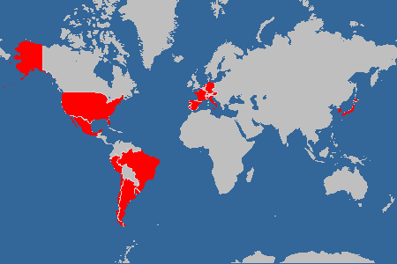
The Doemens Beer Sommelier education strated in 2004
Meanwhile courses available in 17 nations teached in 8 different languages and on 4 continents
Germany
Austria
Switzerland
Netherlands
France
Italy
Spain
Portugal
Brasil
Chile
Mexico
Argentina
Uruguay
Peru
South Korea
Japan
14

Slide 15
Conclusion
Low numbers in beer sales are mainly due to the fact that the customer is served or sold inappropriate beer styles or beer of poor quality
Very often the opportunity for customer loyalty at the point of sale is not sufficiently used
Everybody in beer sales (retailer and gastronomy) should have a basic knowledge of beer to avoid mistakes that can damage the beer quality and advise the consumer properly
The Beer Sommelier Program startd in 2004 deliver the knowledge to main and central person working in the sales sector of beer
A Beer Sommelier is a guardian of highest beer quality, translator and navigator for the customer and a trainer for other colleagues
Customers who drink beer with perfect quality and fits their needs will buy
more of it!
15

