Slide 1

IBD Masterclass III
Education for business and career success
Dr Tim Cooper – IBD President
June 2019
Notes:
Opening remarks – thanks for the invitation to speak etc

Slide 2
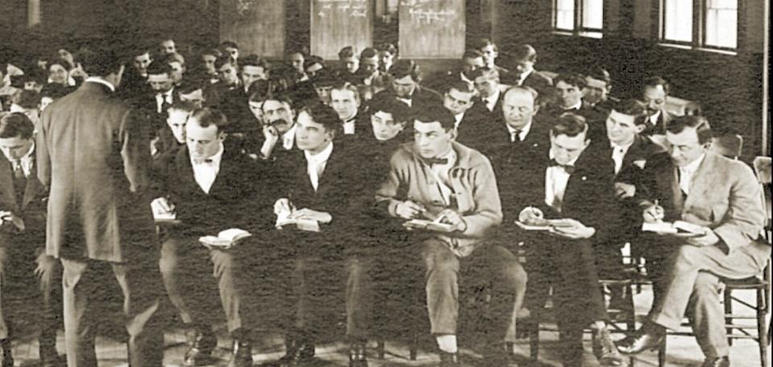
We’ve come along way since 1886…
Notes:
The IBD has always been a place for learning, networking and career development. As business demands have changed the IBD has had to change and adapt. Over the past three years we have dramatically changed how we service the industry with relevant learning materials culminating in internationally recognised, gold standard qualifications. I’d now like to share a short sample of how the IBD qualification process is changing…

Slide 3

Education has moved on, always on… anywhere…everywhere...on multiple platforms
Notes:
… and it’s not just business that is changing – education and particularly adult education has moved on too. The expectation is that learning should always be available – always on, anywhere, everywhere and on multiple platforms.

Slide 4
The changing environment
Global insights on modern adult learning show that learners want:
  to learn whilst working
  to take exams on a more frequent basis, with rapid result feedback
  a global reference point on qualifications
  to be able to know how they are doing during learning
  to be able to ‘talk’ to peers and experts over questions
  to learn in ‘bite’ sized portions rather than via intensive courses
  the learning experience to be more than text books or classroom lectures – for example, videos, interactive models and even VR (!)
Notes:
So how is the IBD responding to the challenge?
First and foremost we have had to recognise the global insights on modern adult learning. For example, learners want to learn whilst working , be able to talk to peers and to learn in bite sized portions.
Note to Tim – can expand this to go through each or keep to examples for timing

Slide 5
Our response
Complete re-write of learning material (Syllabus largely unchanged)
Material written in a conversational style, with a global mind-set and recognising that for many of our customers English is not their first language
All learning material taken online and structured to support modern adult learning
Rigorous process used to ensure material is relevant, correct and well-explained
Notes:
Secondly we have taken a major investment decision to completely re-write all of our learning material and to do this in conversational style with a global mindset recognising that many of our learners do not use English as their first language. All learning material is taken on line and structured to support modern adult learning. We also now have a team of project managers using rigorous processes to ensure the material is relevant correct and well explained. Each project manager has a team of around 30 people writing content, checking content and producing rich learning material such as illustrations, video and simulations.

Slide 6
SUMMARY OF QUALIFICATIONS
Deep knowledge coupled with
operational experience.
Senior technical leadership.
MASTER
Brewing • Distilling
Comprehensive knowledge and theory. Professional springboard for managers and specialists
DIPLOMA
Brewing • Distilling
Packaging
Essential knowledge for operators / technicians / team leaders
GENERAL
CERTIFICATE
Brew • Distilling
Beer Pack• Spirit pack
Malting • Cider
Non-production staff in
industry / Entry for technical /
operational staff
FOUNDATION
Brew/Pack
• Distilling
ibd partnership programme | OUR APPROACH TO PARTNERSHIP 10
IBD PARTNERSHIP PROGRAMME
Notes:
…and the IBD has taken a fresh approach to its portfolio of qualifications. Each one is driven by industry collaboration through constant development of a syllabus and its associated learning material which is moderated by the IBD board of expert examiners from both industry and academia. We have also changed our development and delivery according to a number of important principles:

Slide 7
The IBD Learning & Development ‘Principles’
The IBD owns all its learning material
Learning material is kept fresh and relevant (customers and stakeholders)
IBD approves trainers / tutors
IBD supports career-long learning
Notes:
These four principles are what the learning development function is applying when making decisions and planning activities:
- ‘own material’ includes all text, images (all now unique to IBD with consistent design), videos, animations, simulations, course design.
- new material is designed to be updated. That we can change quickly should advantageous to our customers who want staff to be exposed to the very latest developments.
- we want a globally consistent quality of tutors who tutor / train in the name of the IBD
- over time the IBD should support career learning (e.g. short courses) in addition to qualifications
So for example…

Slide 8
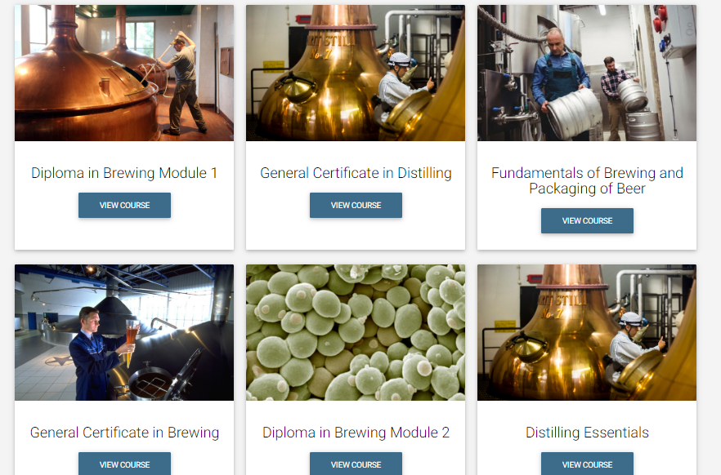
Available courses
Notes:
This is the ‘Home Page’ of the Learning Management System (LMS) – over time it will continue to fill up. Candidates get logon detail as they apply for exams and for companies working as our partners this can appear with their own brand and integrated into the companies own learning systems

Slide 9
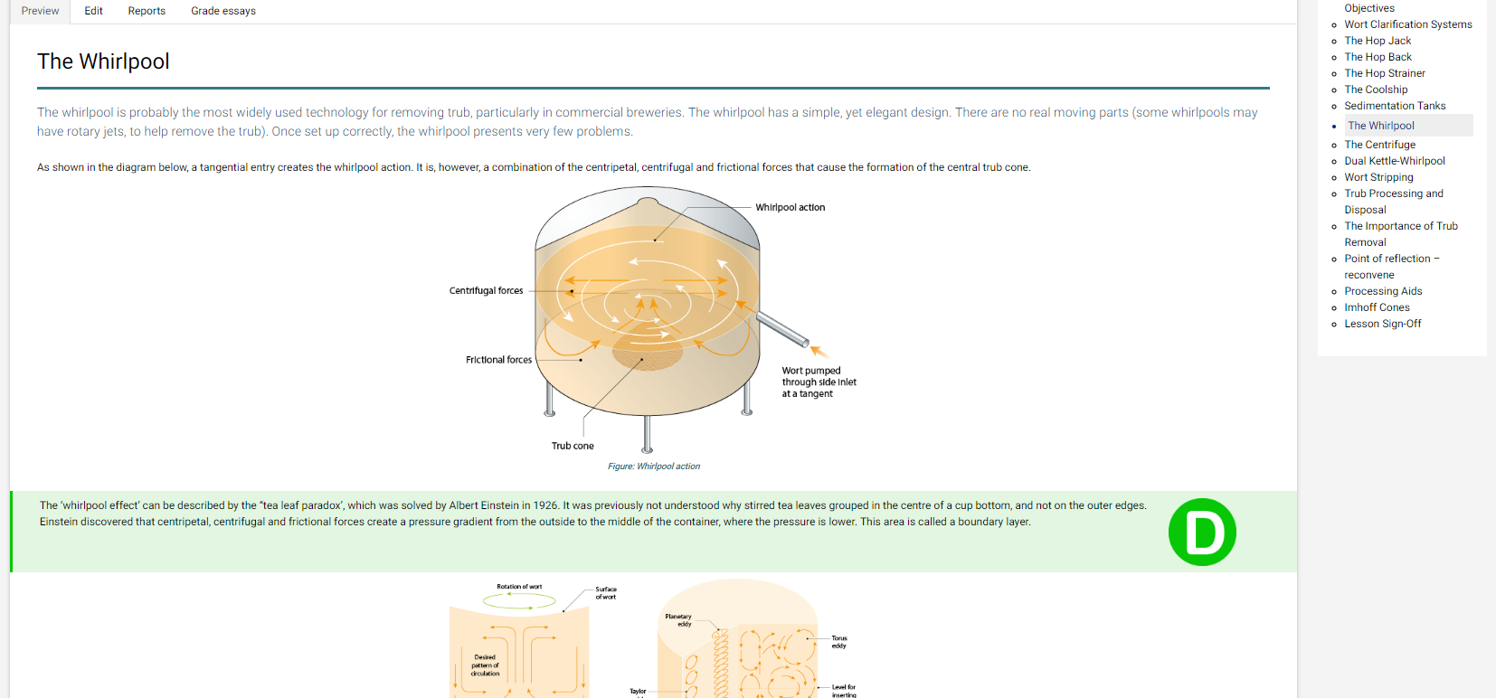
Lesson content
Copyright IBD 2018
Notes:
This is a typical lesson page with illustrations. Text is broken up with elements such as the green ‘D’ section...
D = did you know (some interesting facts)
K = key point that must be understood
R = reflective question requiring the learner to attempt to answer it before turning over to see the answer.

Slide 10
Self-learning can be lonely...
Diploma of Brewing distance learning has been replaced with modern online tutoring
18 week program – whole Syllabus revision; exam preparation; answering of questions; expert guidance
Tutors – 60 responses; 6 selected for pilot
Tutors professionally trained in online tutoring
Went live 14th January 2019
Notes:
However we recognise that self-learning can be lonely so we have just run the first online, tutor guided learning course. It is a separate product from the online learning that is provided as part of the exam fee. It currently costs c. 1000 euros for the 18 weeks program. Tutors are subject matter experts who have been professionally trained to tutor online ..’

Slide 11
Tutor-guided learning
Tutors can be located anywhere (currently Hong Kong, London, Cape Town, Dublin)
Sessions staggered on different days / time zones
Remunerated role
All tutors use IBD developed tutoring slides to complement the online learning material
All questions answered via internet forum
All sessions recorded
Notes:
… we also cover 3 different time zones so tutors are available to suit the candidates locations and all sessions are recorded in case a candidate cannot attend. All of this is also backed up by the possibility to attend face to face courses.

Slide 12
Innovations
IBD ‘Partner Portal’
IBD material can be accessed through branded Learning portal; additional company material can be incorporated, such as brand information and resources for learners
IBD maintains the information and infrastructure
Client has access to data – e.g. progress of students; items of learning difficulty that allow specific actions to be developed
Notes:
We are now offering companies a partner portal. This is offered to help corporates who want ‘everything in one place’. It is very professional looking and is easily set up. It is intended as a service to provide added value. So far this is being used by one international brewer and one global distiller with ongoing discussions with many others.

Slide 13
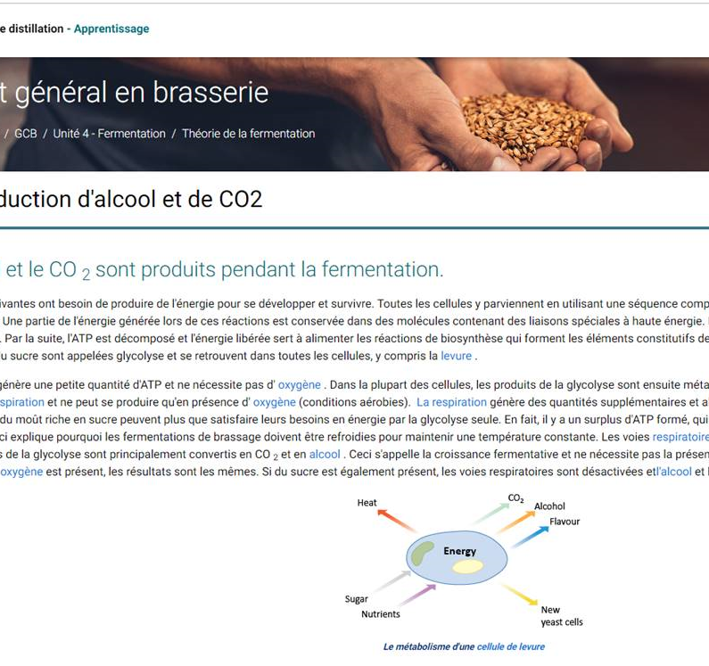
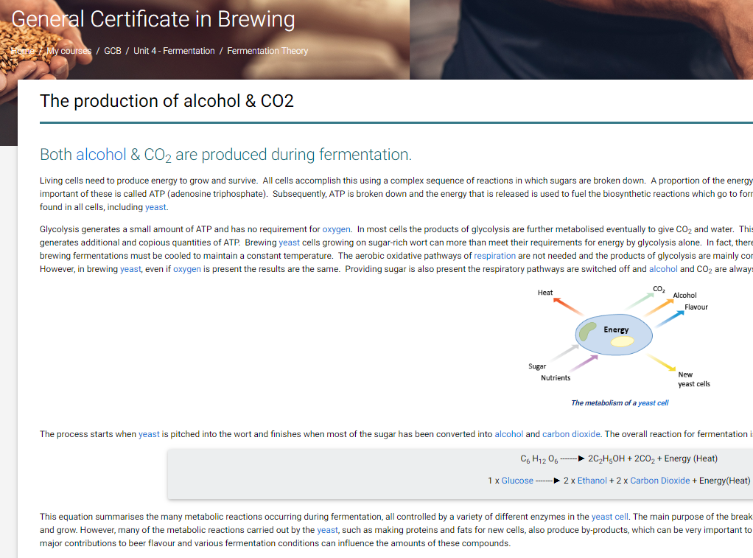
What’s possible...rapid translation
Notes:
Translation used to take a long time and was very expensive...technology is rapidly changing that...and we intend to deliver courses with language partners in French, Spanish, Portuguese and Mandarin Chinese.

Slide 14
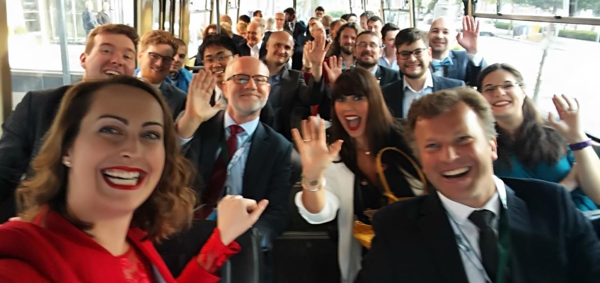
Come and join us on the journey
Notes:
The IBD has started on a journey of continuous improvement to its well-respected and recognised qualification pathway to career development. You’re very welcome to join us on this journey.

Slide 15
Thank you!
For further information:
Jerry.avis@ibd.org.uk

